Slide 1


Accounts Payable Operations and Reporting in Oracle ERP

Slide 2
Presented By:
Nour Mohamed Shafiq Habib
Salma Ezz El-din Mostafa Kamal
Omnia Magdy Mahmoud Kandil
Salma Mohamad Abd EL-Aziz
Amany Essam El-deen
Alaa Adel Yassin Ali
Supervised By:
ENG: Ahmed Maged

Slide 3
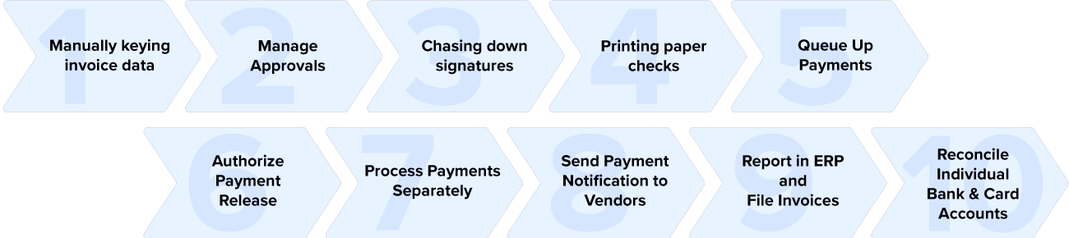
What is Accounts Payable ?
Accounts payable is a series of transactions starting by creating purchasing order, passing by requesting and receive invoice from suppliers till paying to the suppliers as shown in the following figure:

Slide 4
Why Automating Accounts Payable ?
By considering Accounts payable department as a key factor any company as it plays a critical role in sustaining any company's financial health, it should be highlighted and given utmost importance to be involved in the automation process implemented by the technological boom nowadays.
To be more accurate there are some problems and challenges faced by AP department using old systems and how those problems can be illuminated by implementing oracle system.

Slide 5
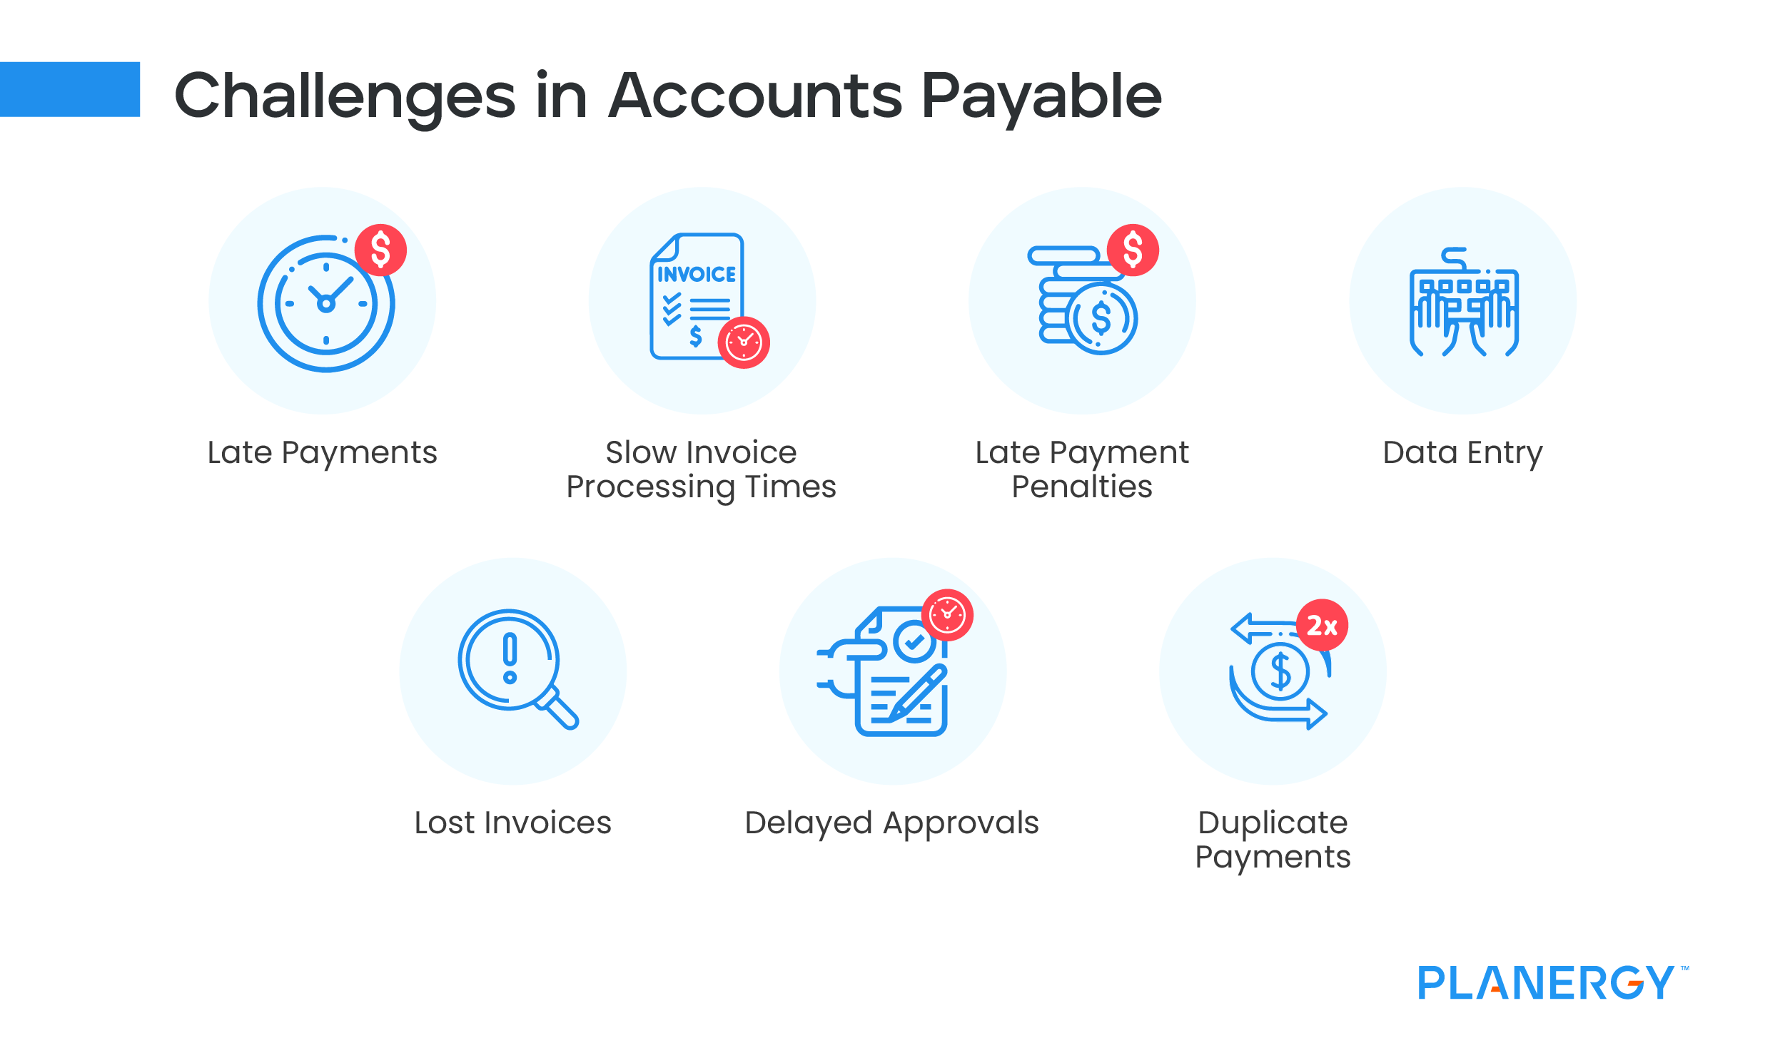

Slide 6
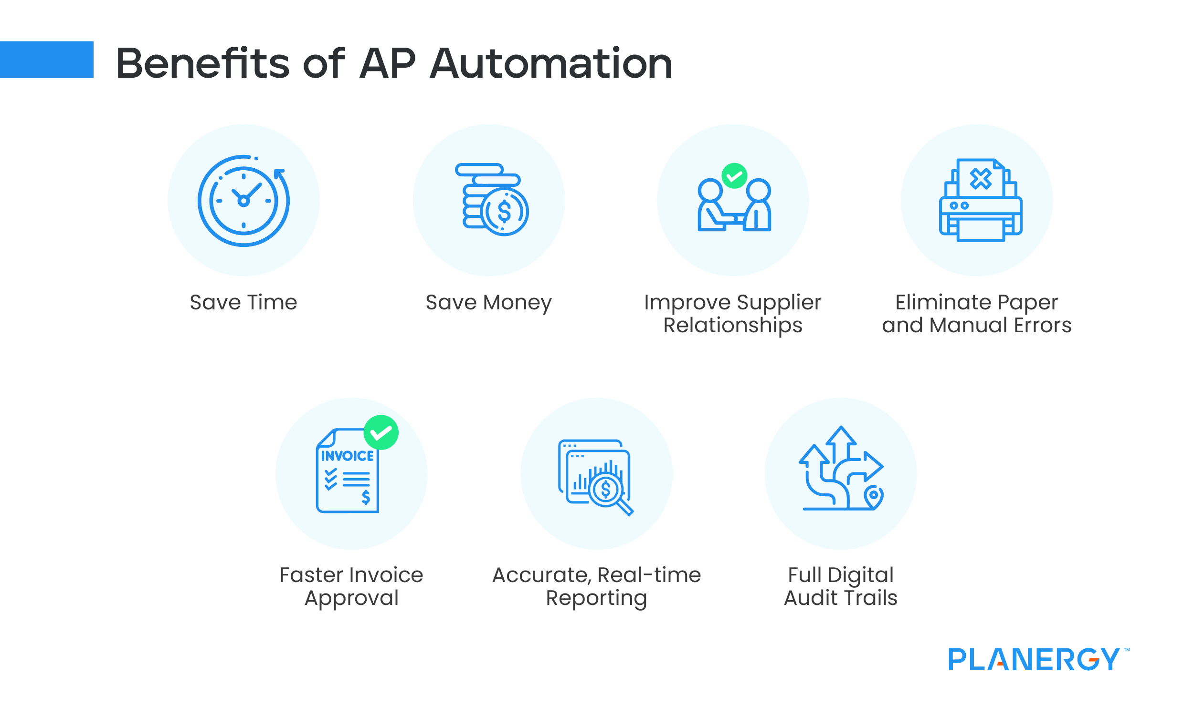

Slide 7
How can we Automate Accounts Payable module using
Oracle ERP system ?

Slide 8
Oracle ERP System for Accounting
AP

Slide 9
Steps to Automate AP System Using Oracle ERP System
Create & Manage Supplier Invoices
Invoice Adjustment & Holds
Supplier Inquiry
Process Supplier Payments
Handle Prepayments & Advances
Void Payments and Refunds
AP Period-End Close
Generate Financial Reports
Reconciliation with General Ledger
Manage Write-offs and Adjustments
Supplier Invoice & Billing
Payment Processing & Cash Management
Period-End Closing & Reporting
Step 1
Step 2
Step 3

Slide 10
Al Nile For Furniture Year Ended 2017
Suppliers
El Hoda
El Salama مسامير و مستلزمات نجارة
شركة الخليل للاخشاب
El Nour للاخشاب

Slide 11
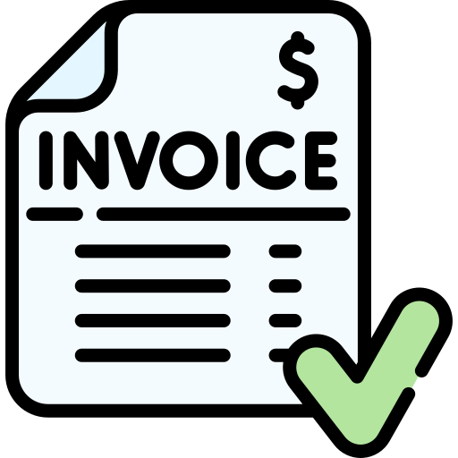
1. Manually create supplier invoice
(Create Supplier)
Supplier entry.
Create new organization (supplier name ,number).
Address book Shape create address (address line 1, address name ,registry ID)
Address site
Connect purchasing and payment
Links with the operating unit (vision operations) .
4. Apply.
B. Invoice Matching (PO Matching)

Slide 12
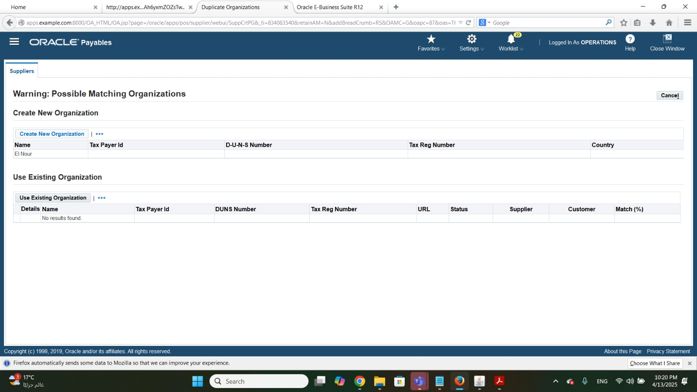
Creating Suppliers for Al Nile for furniture

Slide 13
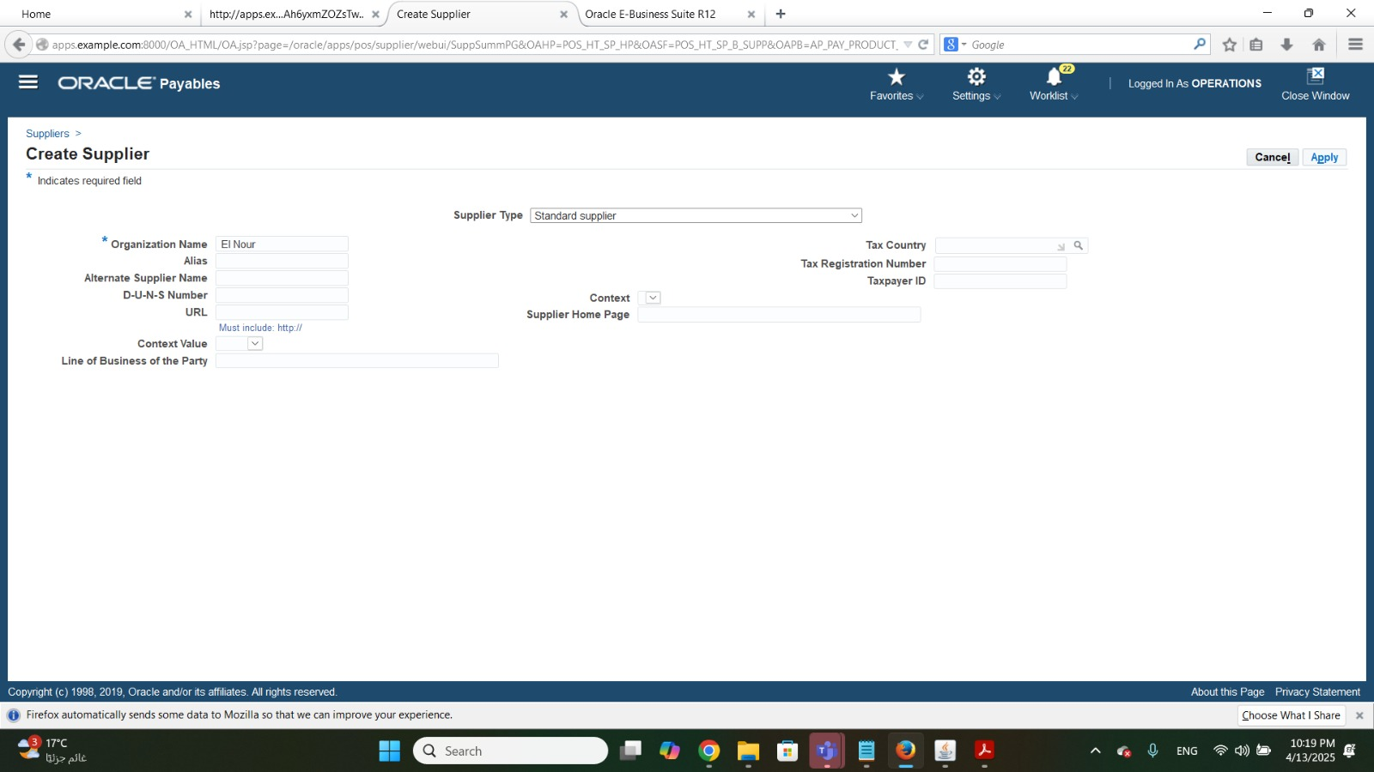
Creating Suppliers for Al Nile for furniture

Slide 14
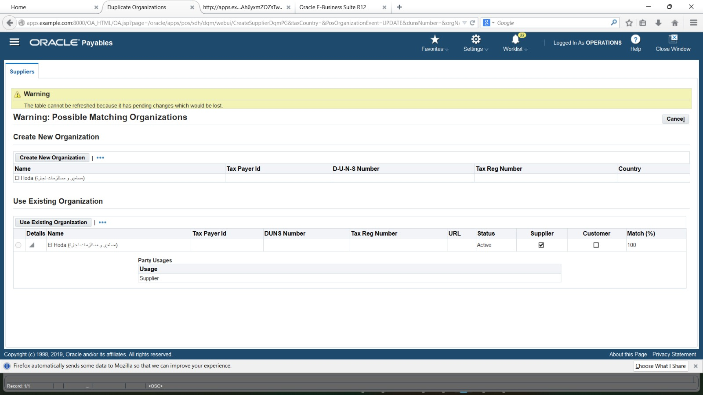
Creating Suppliers for Al Nile for furniture

Slide 15
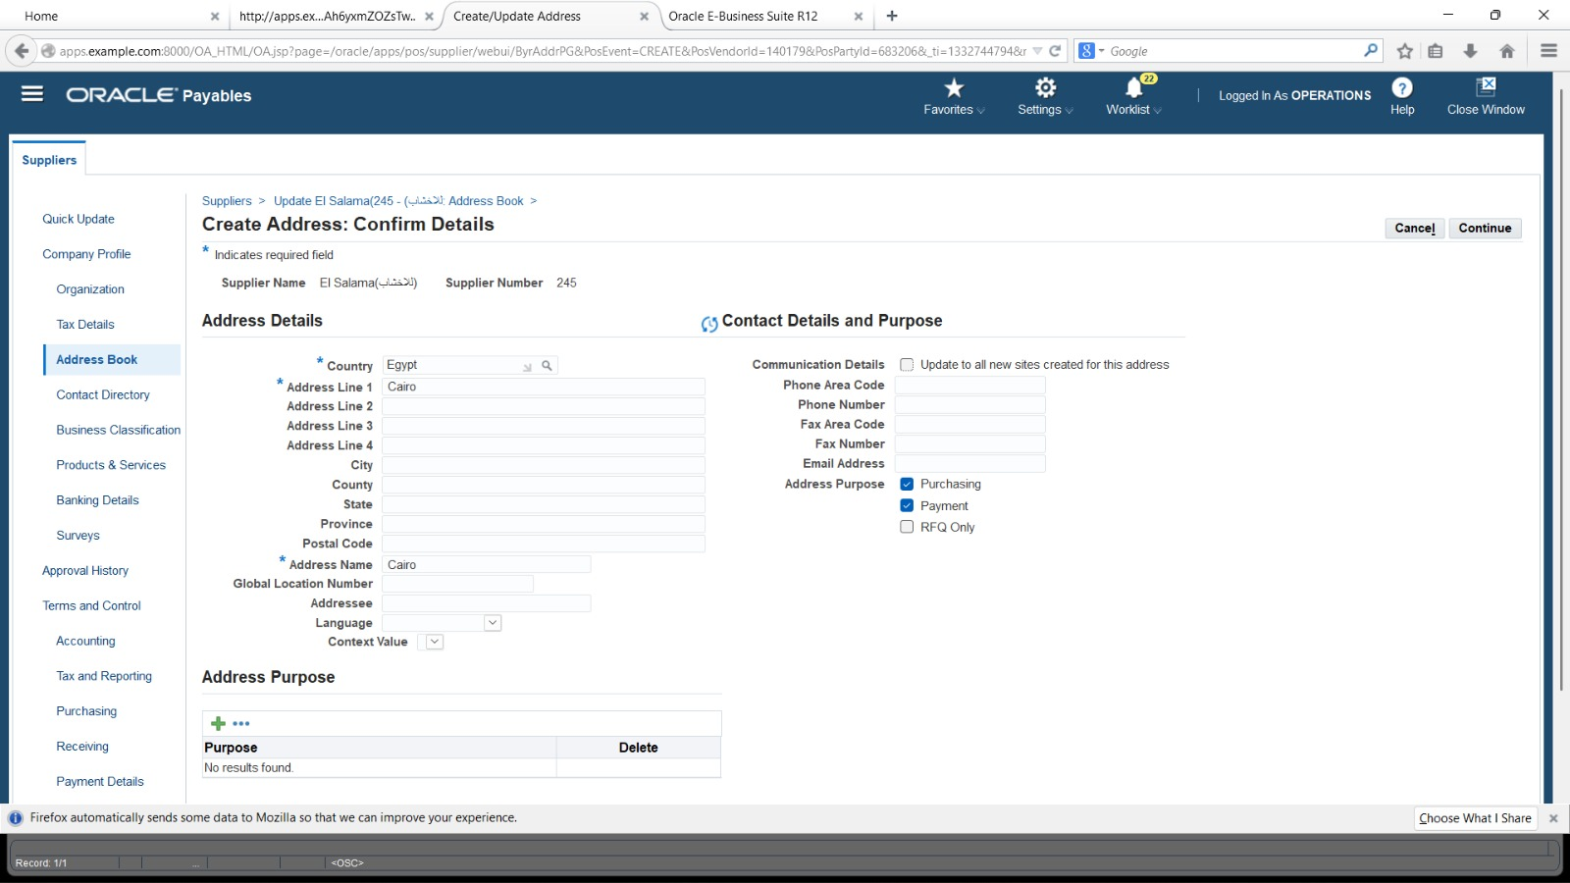
Add Suppliers’ detailed Information

Slide 16
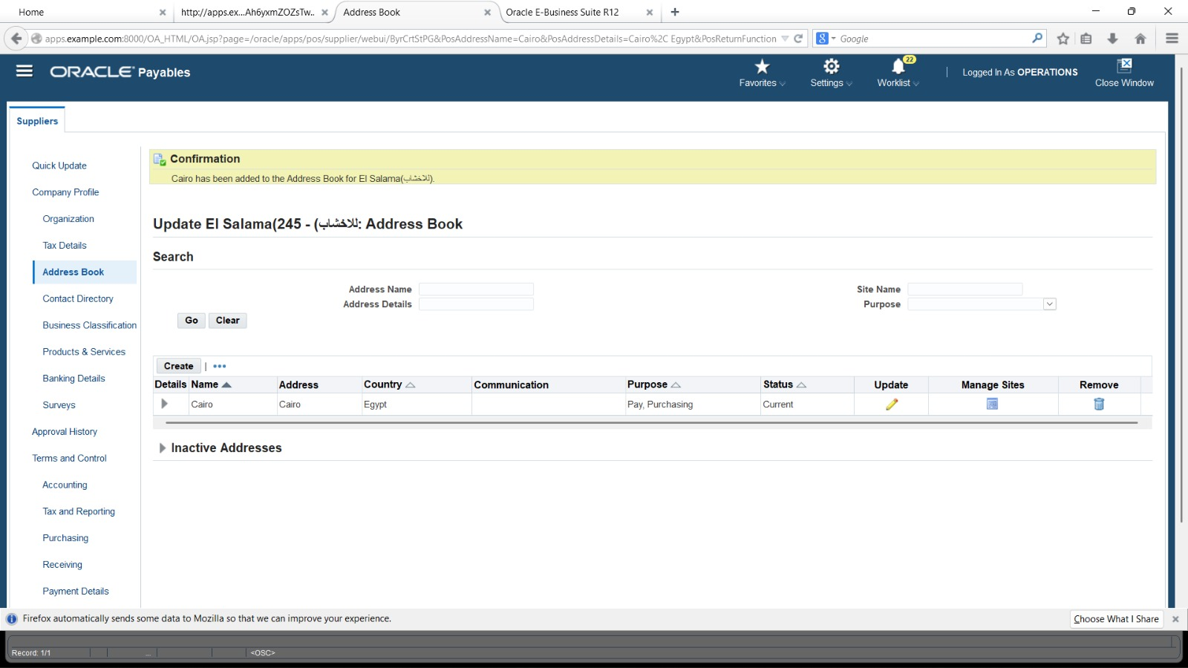
Add Suppliers’ detailed Information

Slide 17
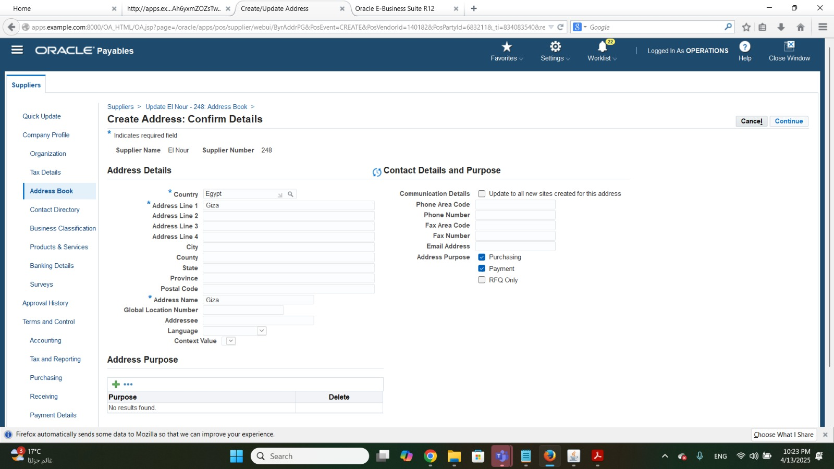
Add Suppliers’ detailed Information

Slide 18
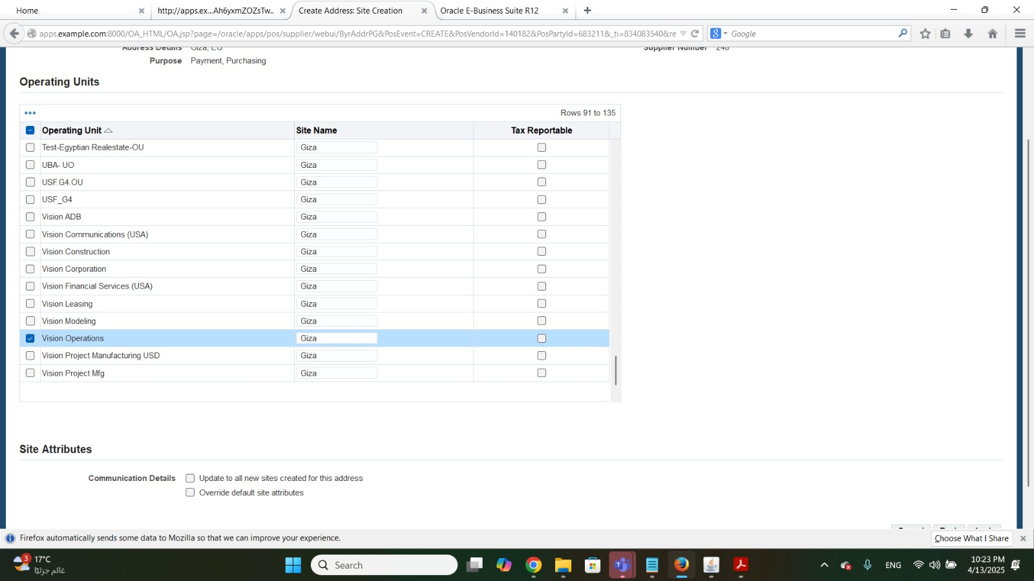
Add Suppliers’ detailed Information

Slide 19
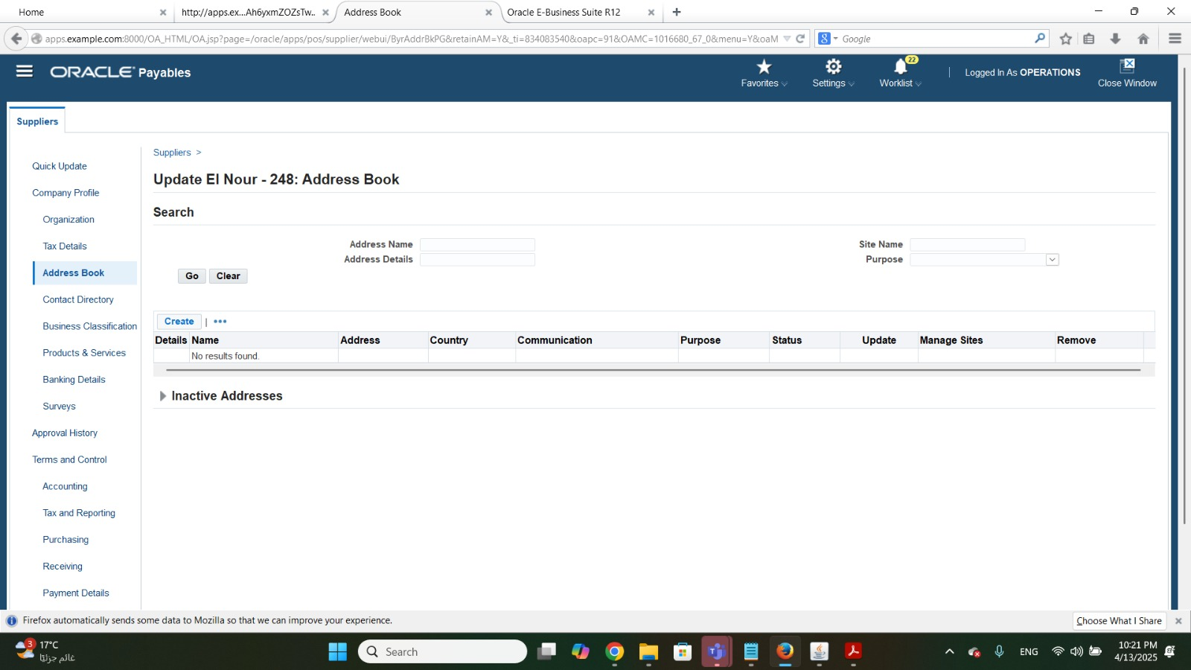
Updating existing Suppliers’ Information

Slide 20
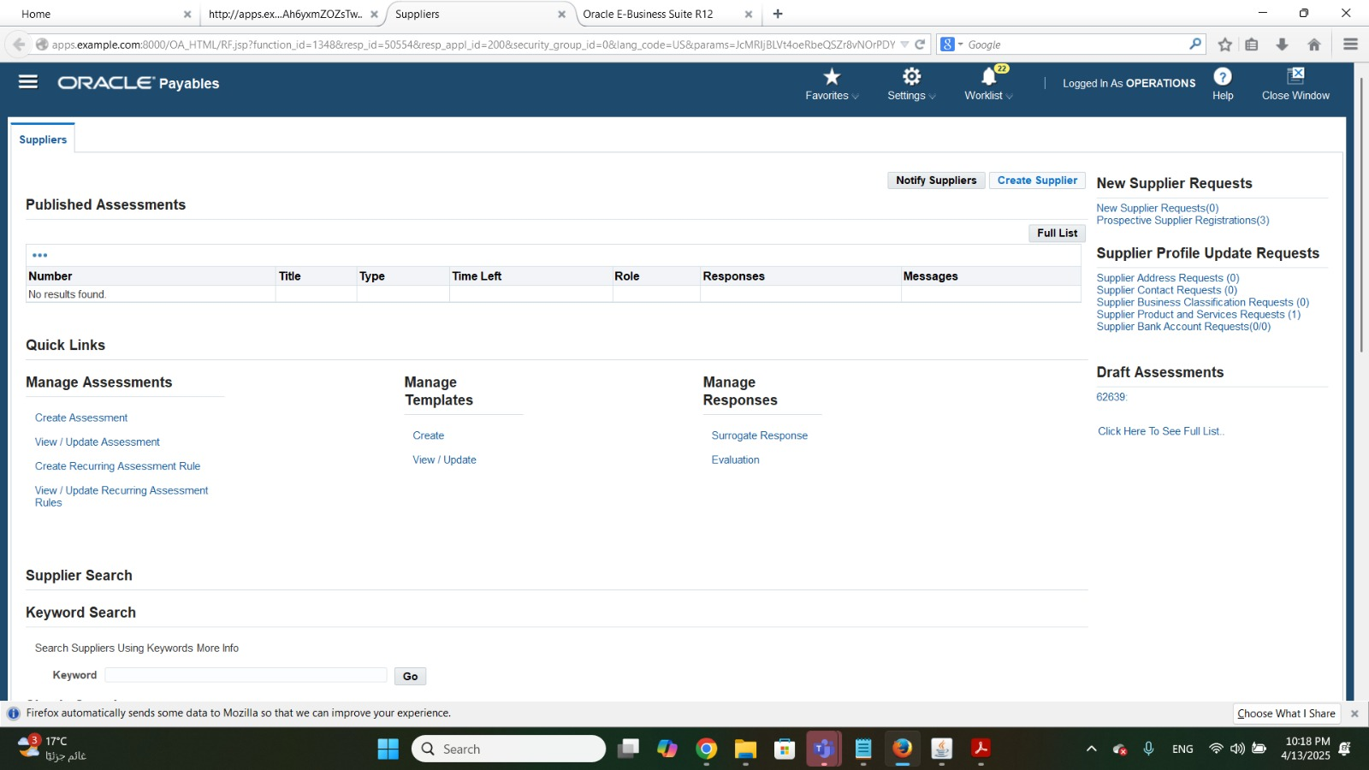
Updating existing Suppliers’ Information

Slide 21
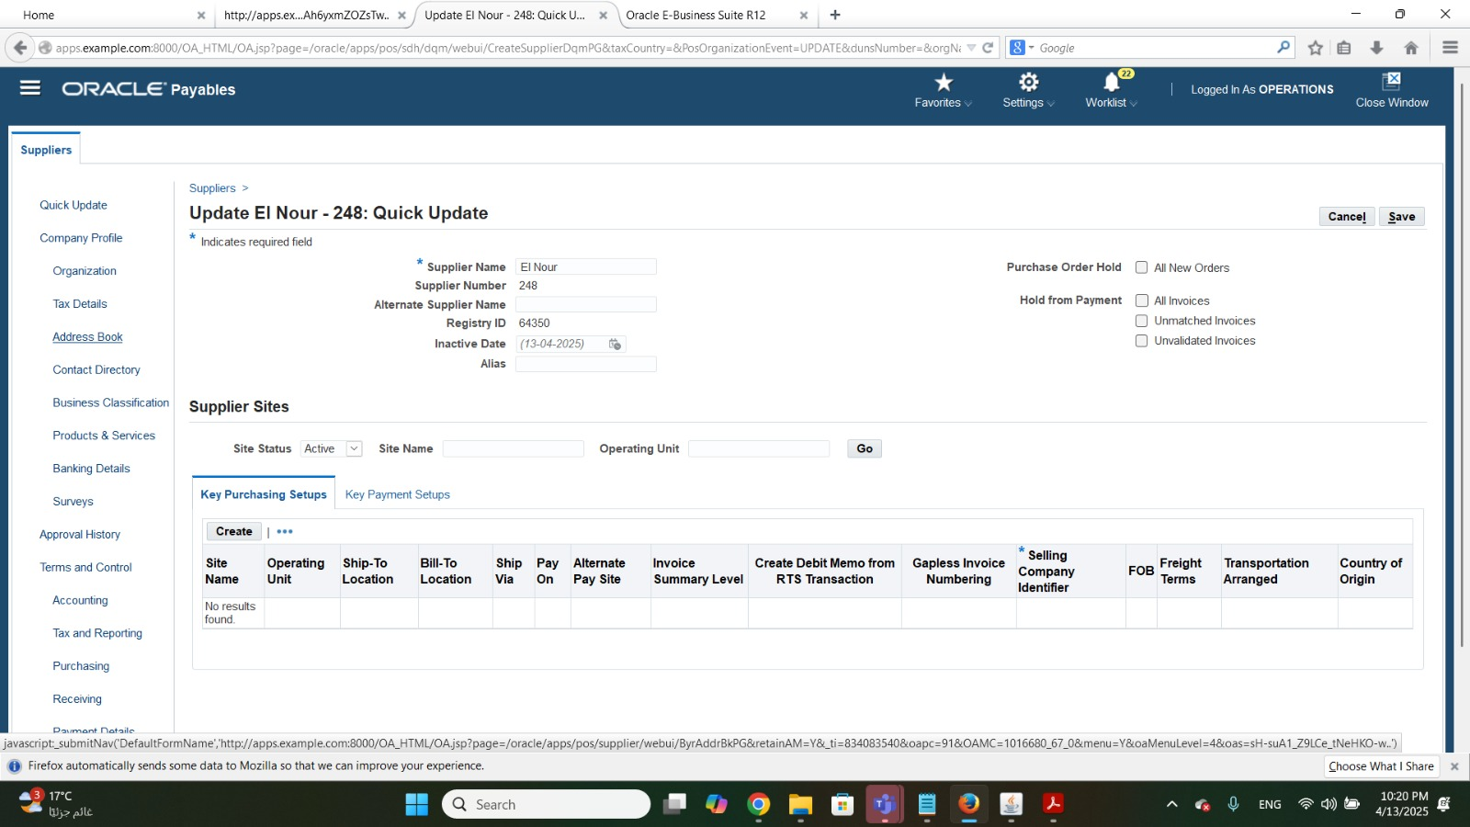
Updating existing Suppliers’ Information

Slide 22
AP
Step 1: Supplier invoice & Billing

Slide 23
Step 1: Supplier Invoice & Billing
A. Create & Manage Supplier Invoices
B. Invoice Adjustment & Holds
C. Supplier Inquiry
Manually create supplier invoice then, entering invoice details such as supplier information, payment terms and line items.
B. Invoice Matching (PO Matching)
Applying adjusments to supplier invoices such as discount, taxes then, placing invoices on hold and release holds based on supplier’s agreements.
Using the inquiry tool to view supplier account details, outstanding invoices & payment history.

Slide 24
1. Manually create supplier invoice
B. Invoice Matching (PO Matching)
(Create Invoice)
Path: Invoice → Entry invoice.
Enter invoice datils like(Category Name – Invoice Type – Supplier Name – Lines of the Invoice ) .
Action on invoice → Validate → Action → Create account final post.(To make invoice Validated)

Slide 25
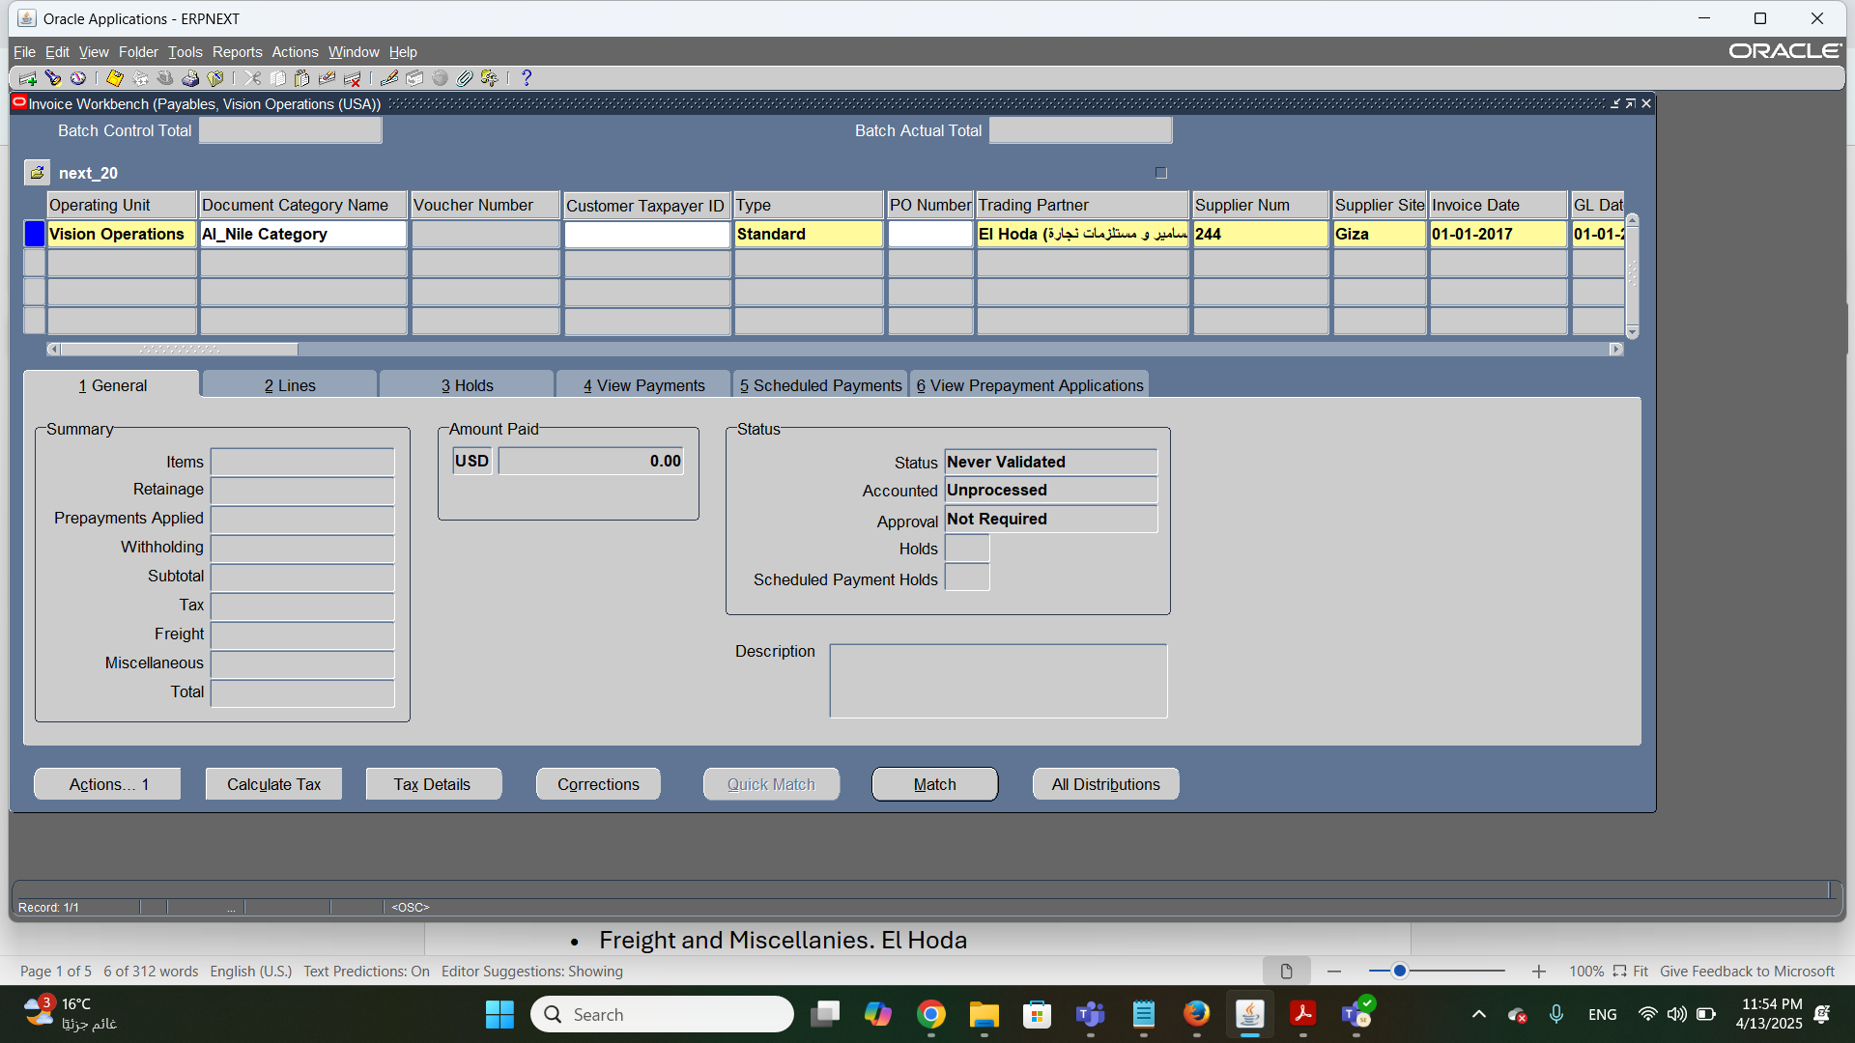
Creating Supplier’s Invoice

Slide 26
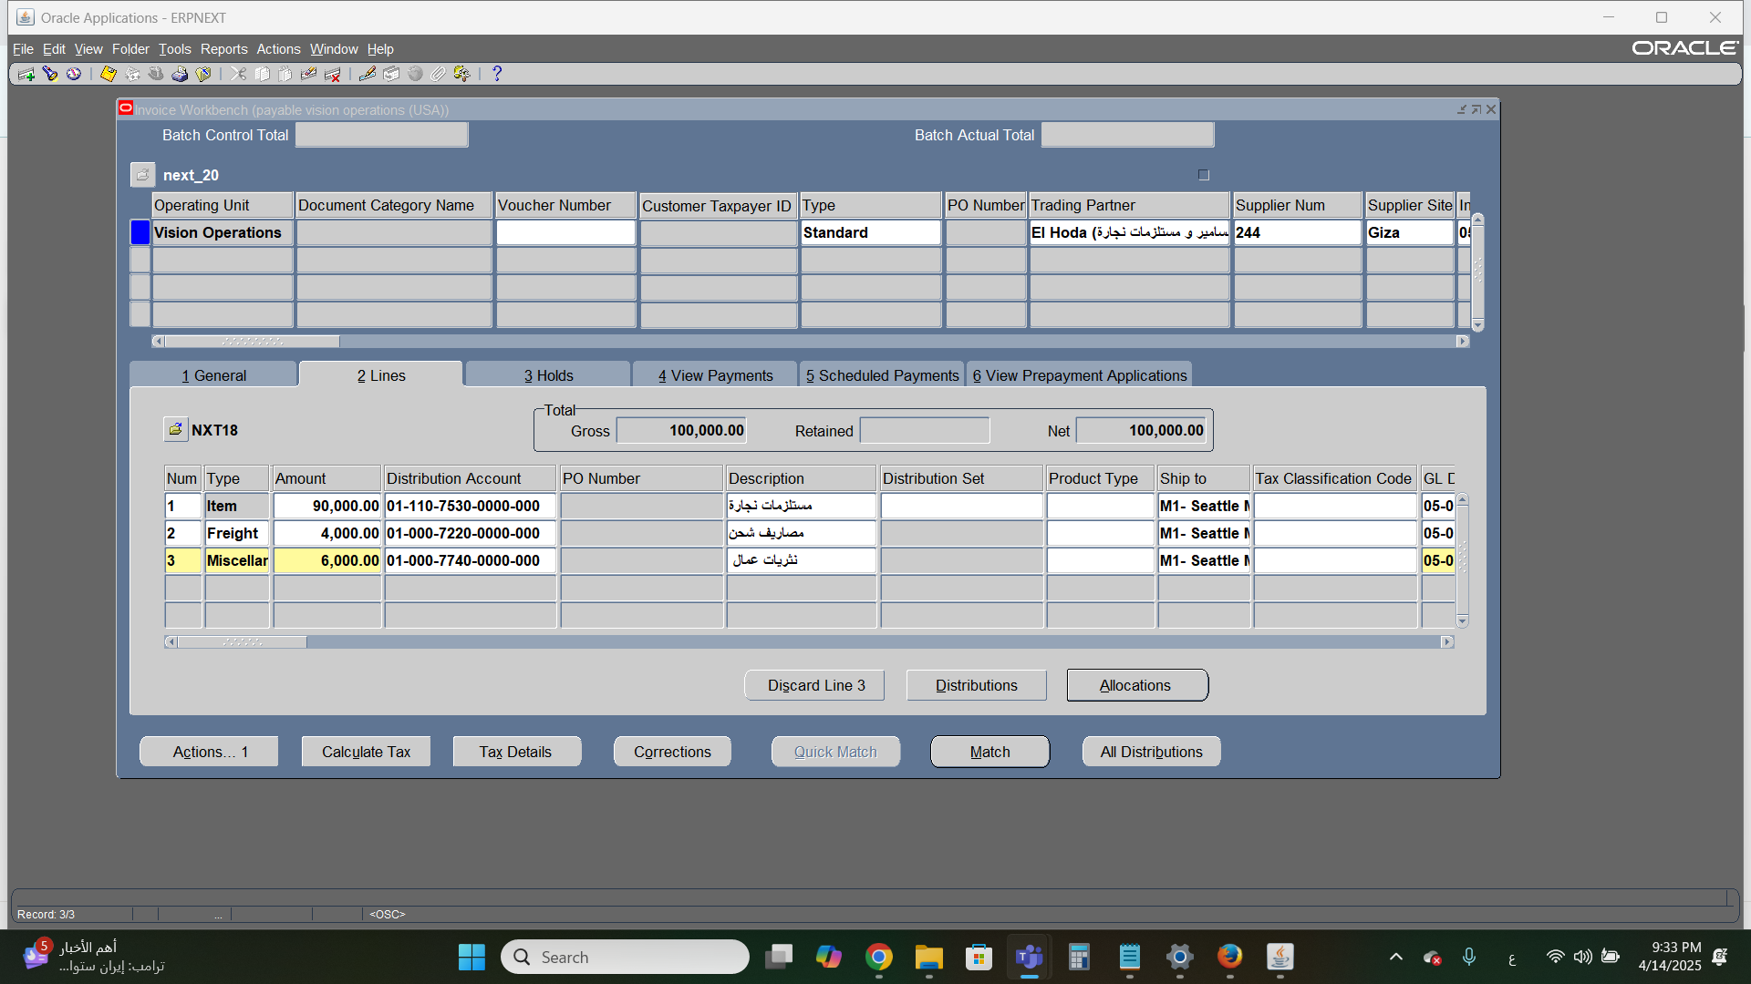
Creating Supplier’s Invoice

Slide 27
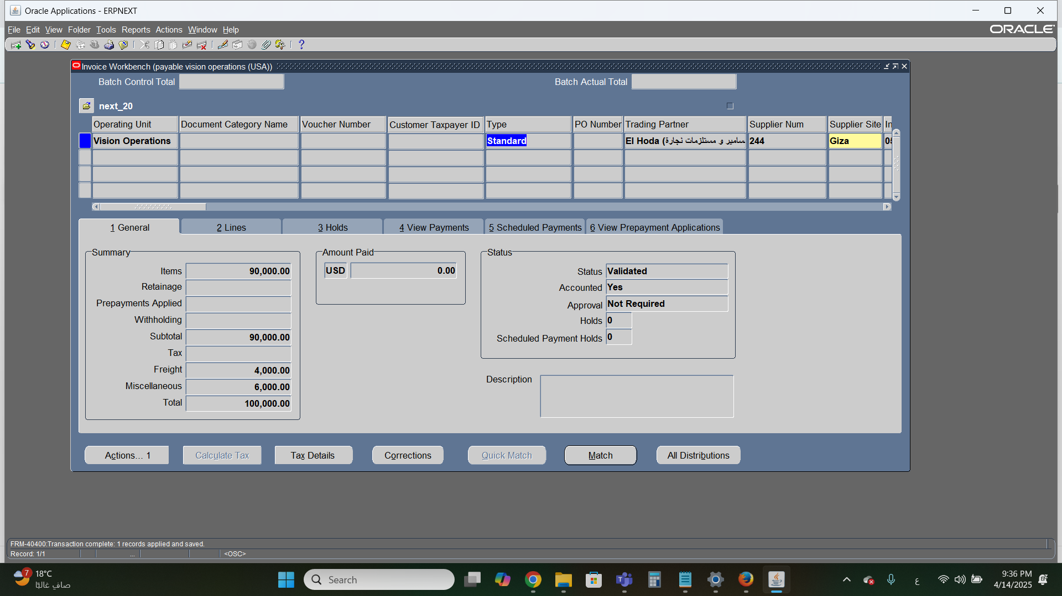
Creating Supplier’s Invoice

Slide 28
AP
HOLDS FOR INVOICES

Slide 29
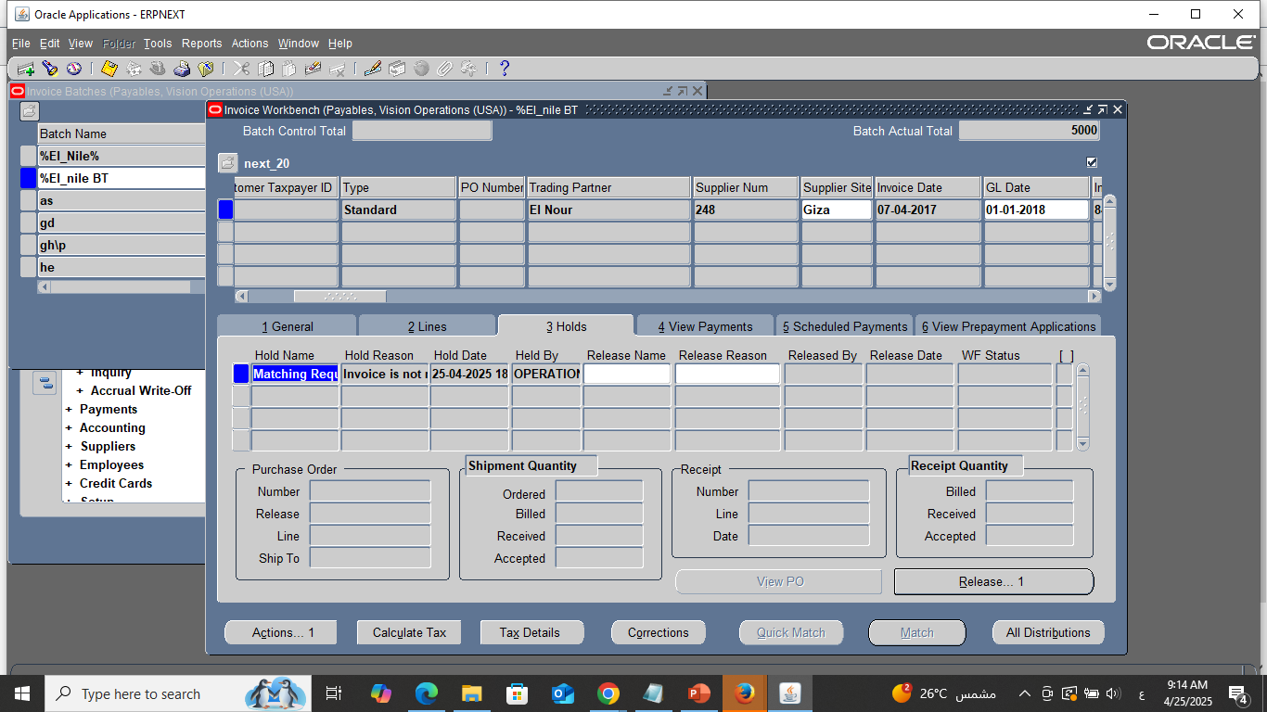
1. Hold for invoices
B. Invoice Matching (PO Matching)

Slide 30
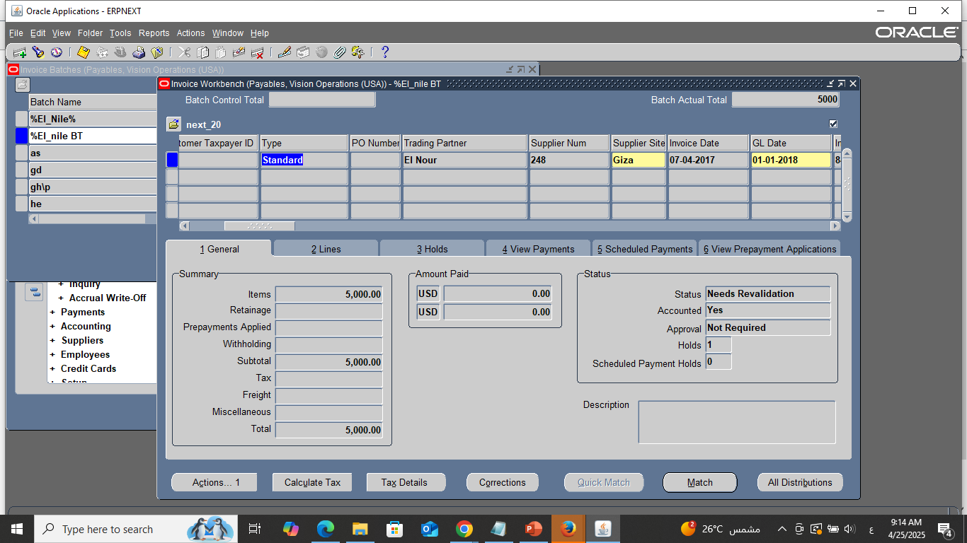
Mannual Hold for invoices
B. Invoice Matching (PO Matching)

Slide 31
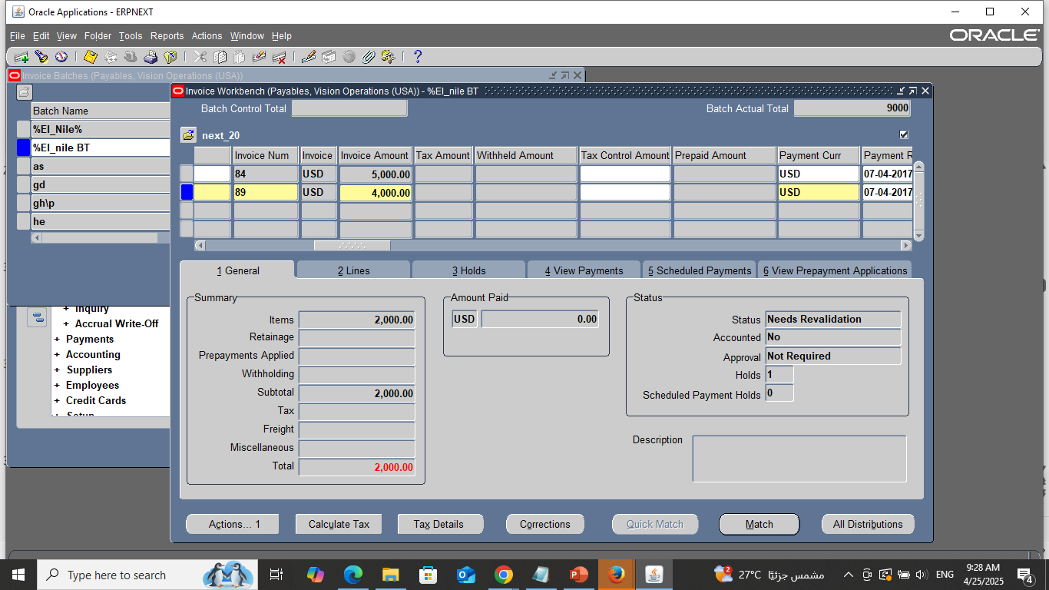
Automatic Hold for invoices
B. Invoice Matching (PO Matching)

Slide 32
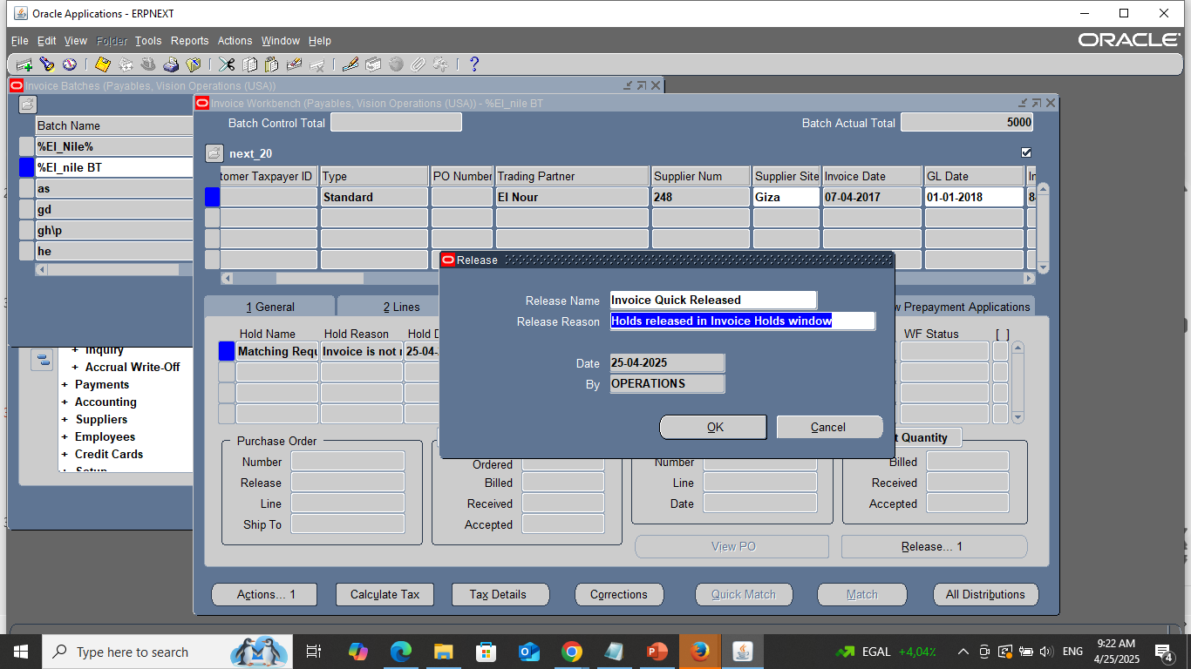
Release holds invoices

Slide 33

3. Supplier Inquiry
(Use the inquiry tool to view supplier account details)
View →requests → submit new request
Name(Supplier Payment History)
Operating Unit (Vision Operation)
Parameter (Name: EL _NOUR ,Invoice Detail: yes, Order By Option: Payment Date)
OK → Submit.
All My Request → Find → View Output.
B. Invoice Matching (PO Matching)

Slide 34
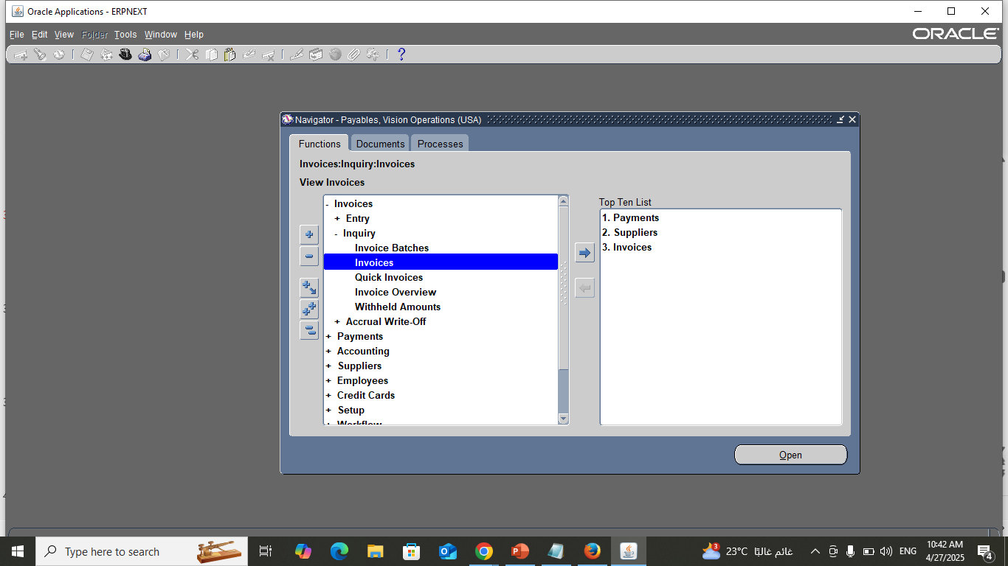
3. Supplier Inquiry
- First way
B. Invoice Matching (PO Matching)

Slide 35
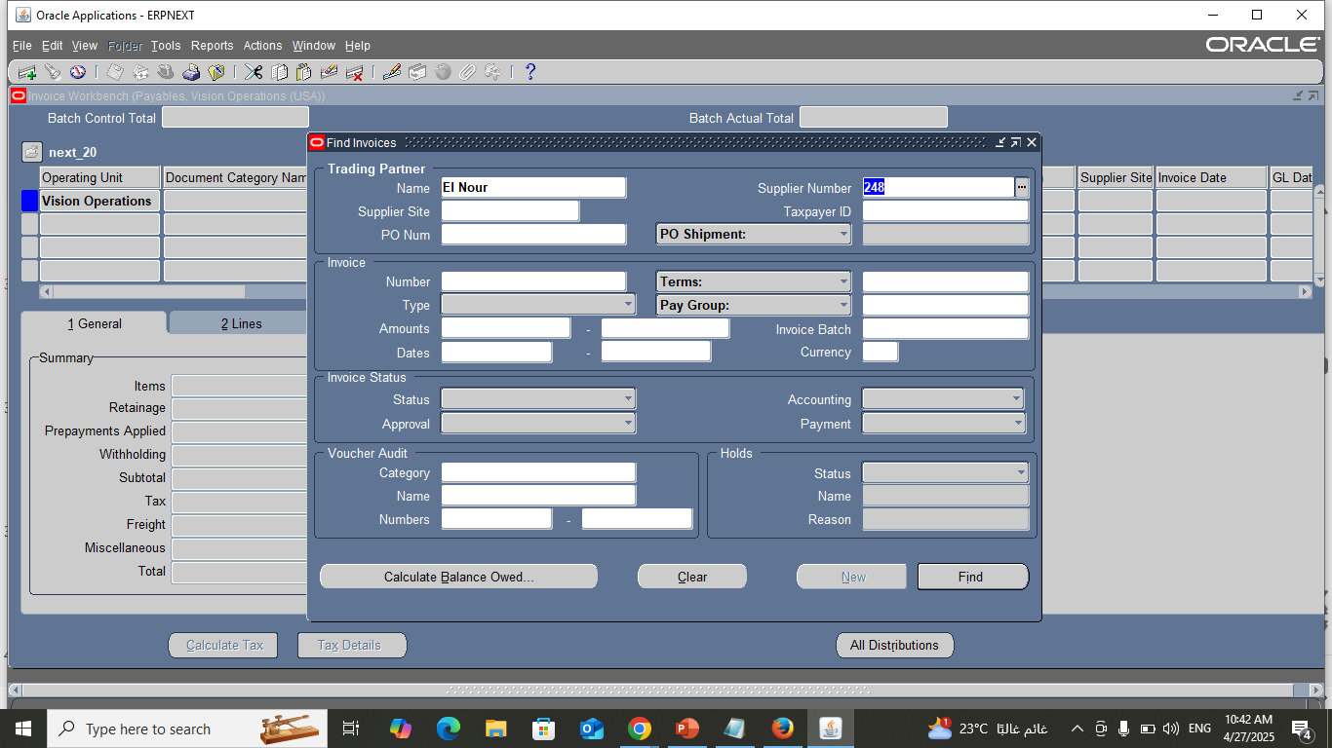
3. Supplier Inquiry
B. Invoice Matching (PO Matching)

Slide 36
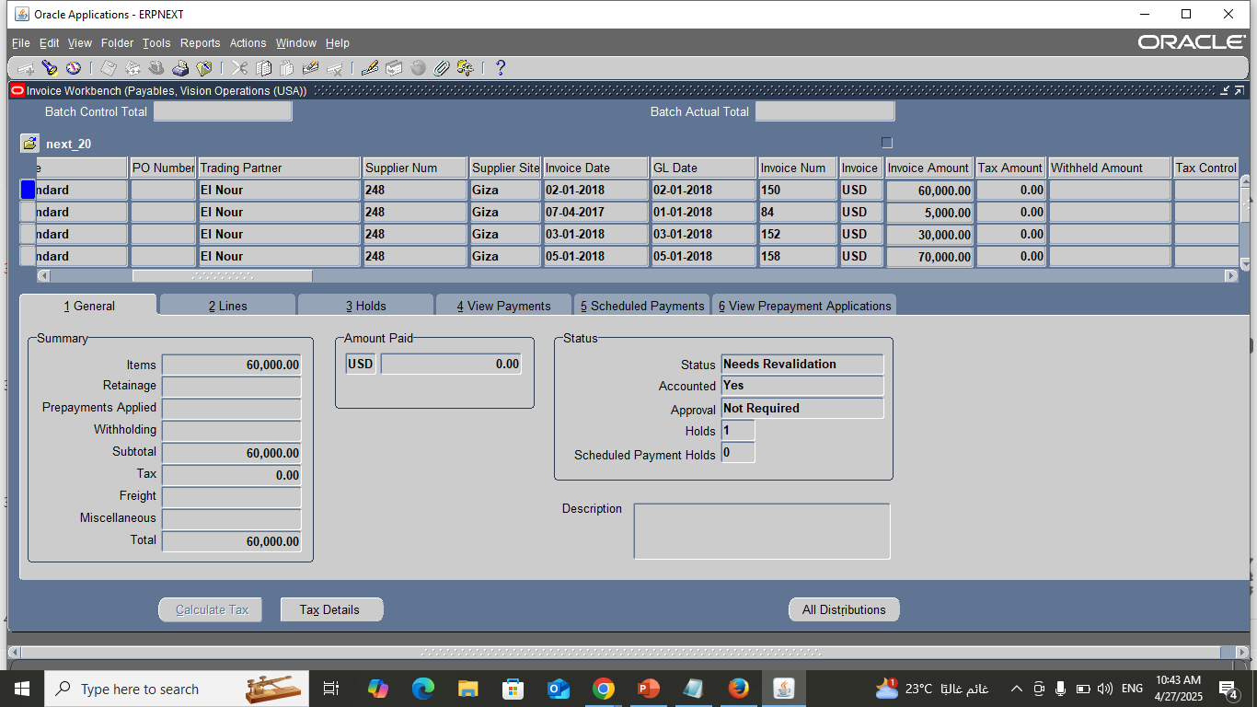
3. Supplier Inquiry
B. Invoice Matching (PO Matching)

Slide 37
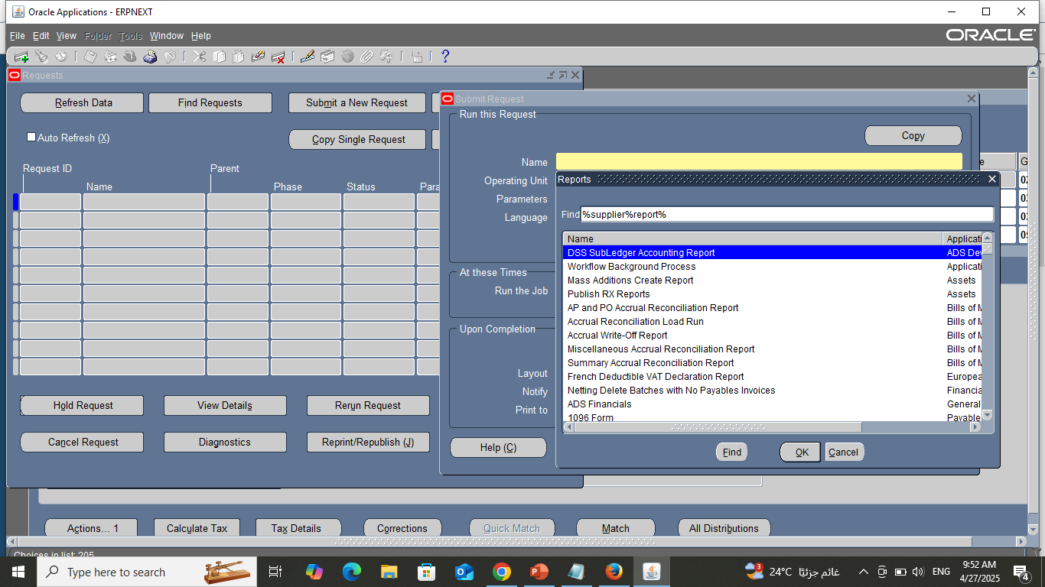
Searching for supplier “Supplier’s Inquiry”
- Second way

Slide 38
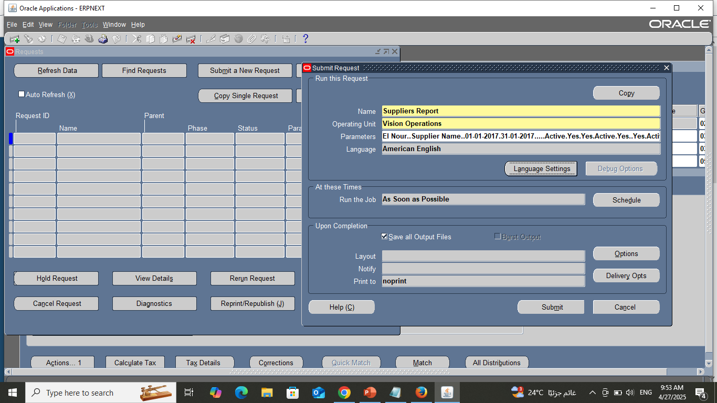
Searching for supplier “Supplier’s Inquiry”

Slide 39
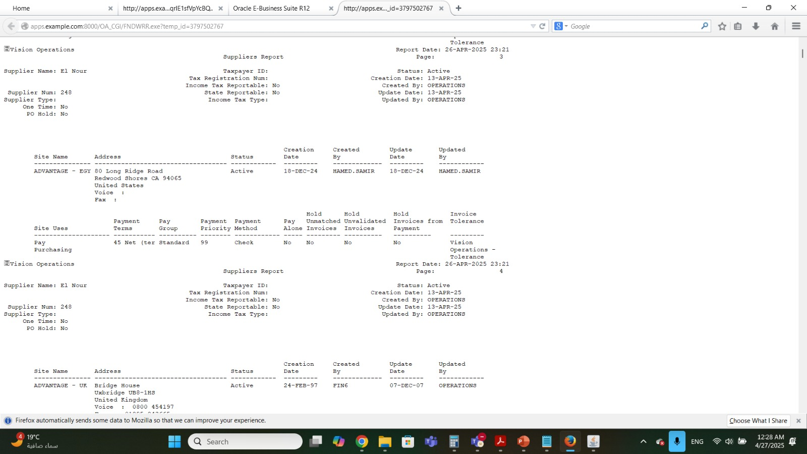
Searching for supplier “Supplier’s Inquiry”

Slide 40
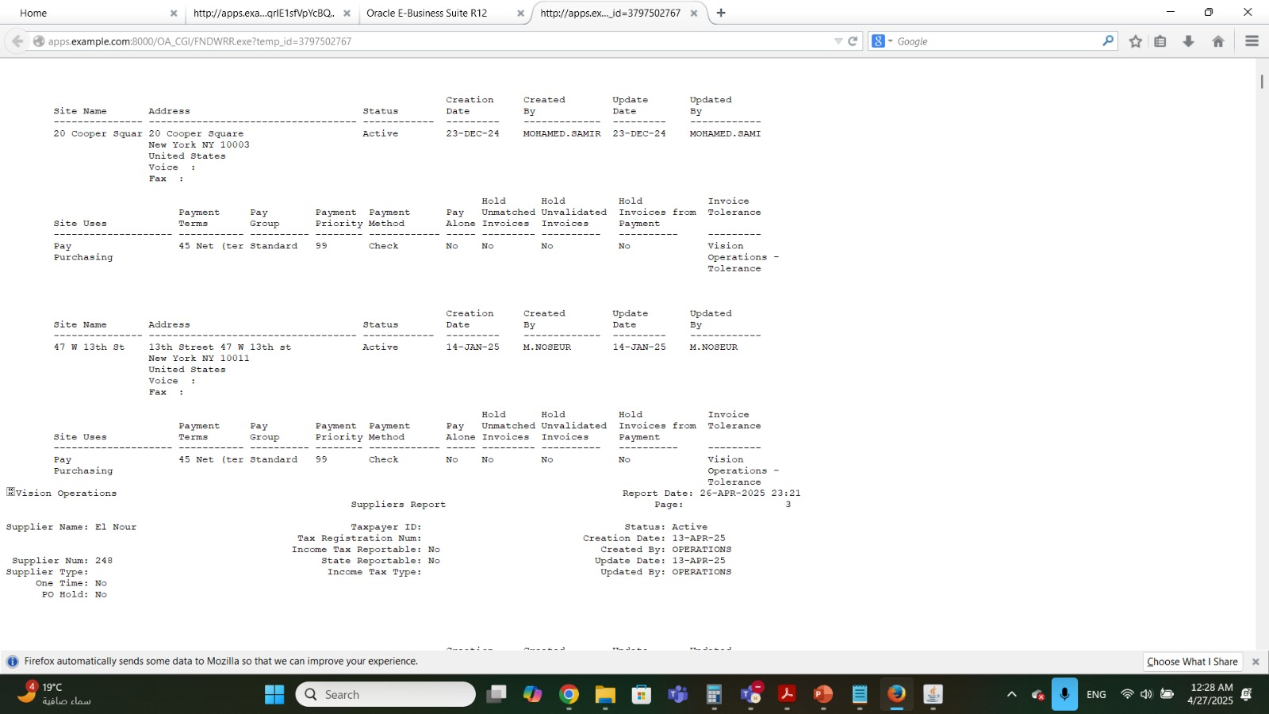
Searching for supplier “Supplier’s Inquiry”

Slide 41
2. Invoice Adjustments (credit memo& Taxation)
B. Invoice Matching (PO Matching)
(Apply adjustments (e.g., discounts, taxes, credit memo) to supplier invoices)
Make adjustment Tax to a Supplier invoice so choose one.
After make lines on an invoice → Tax Details → Choose Regime code for our company Which is AL_NILE TAX and write the other information.
Apply the adjustment by Click OK.
Make Report to ensure that the adjustment is applied.

Slide 42
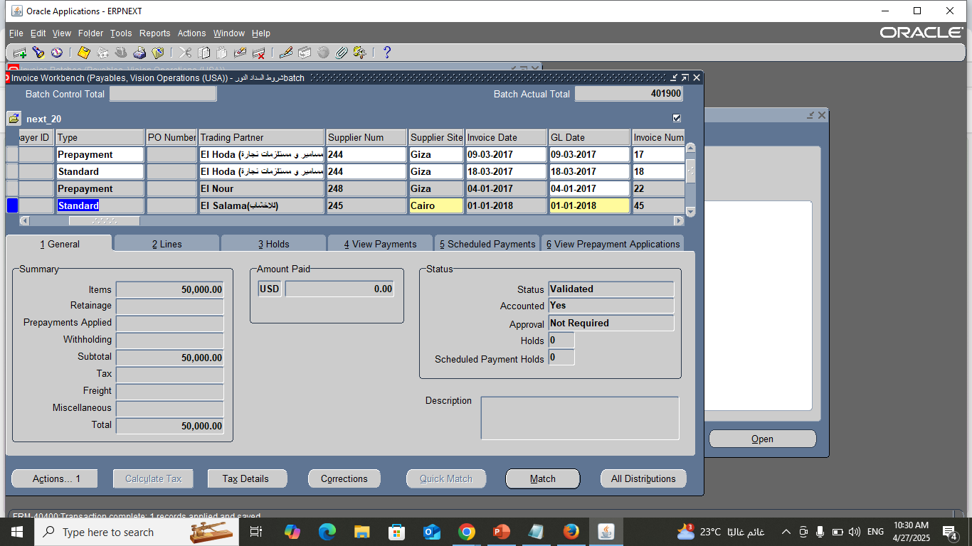
Stander And Credit Memo Invoice

Slide 43
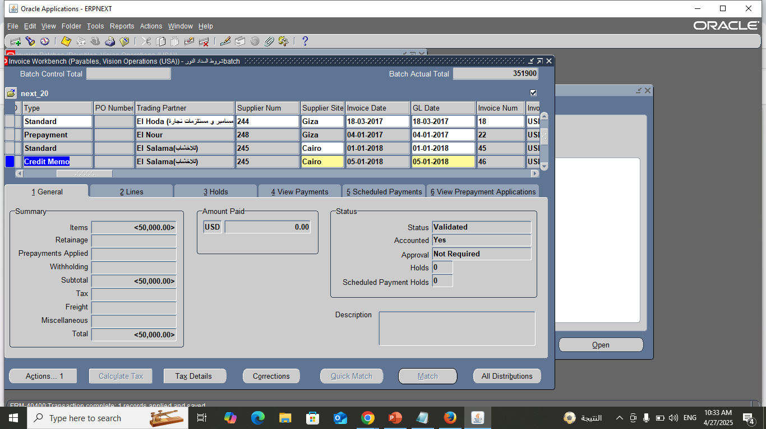
Adjustments Credit Memo

Slide 44
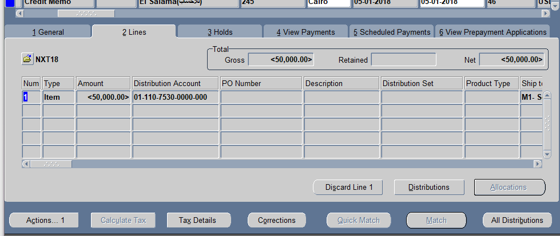
Adjustments Credit Memo

Slide 45
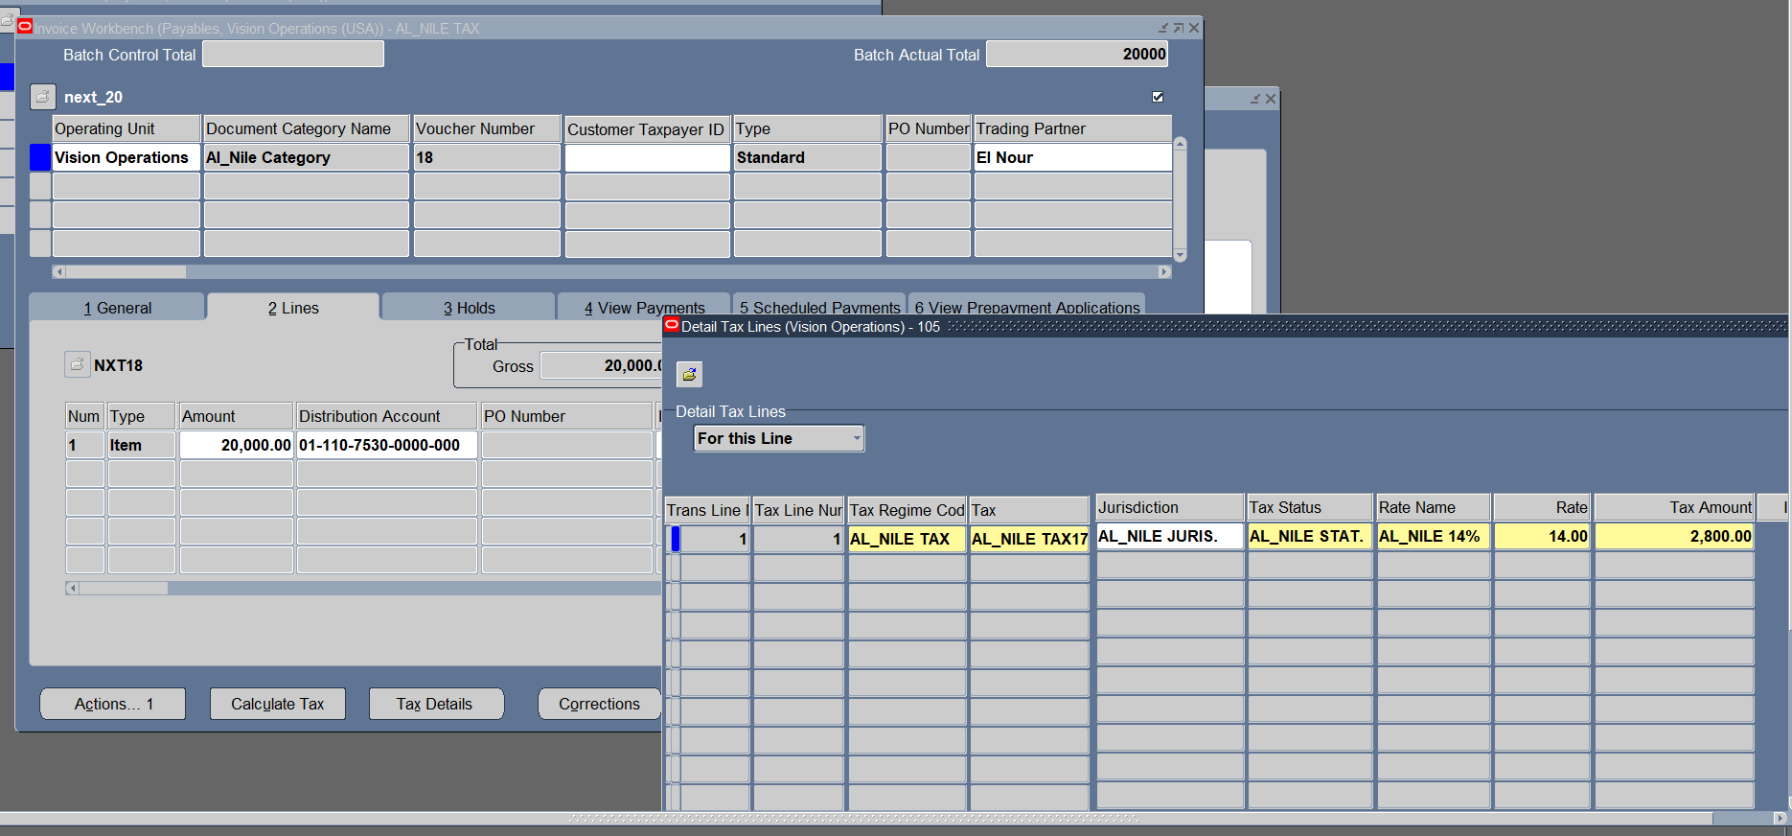
Adjustments Taxation

Slide 46
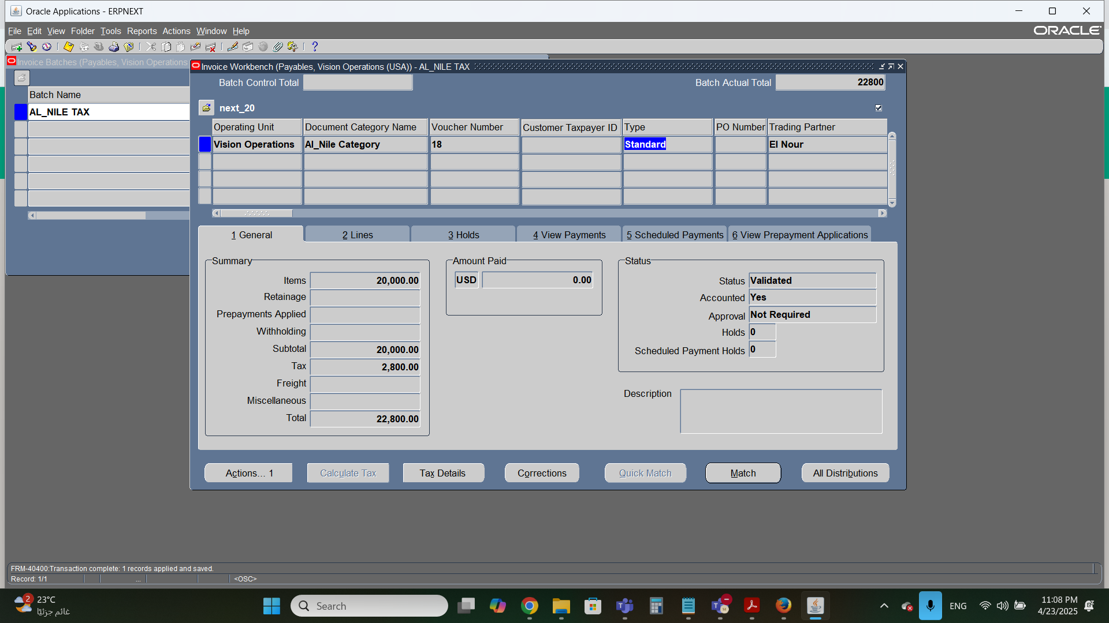
Adjustments Taxation

Slide 47
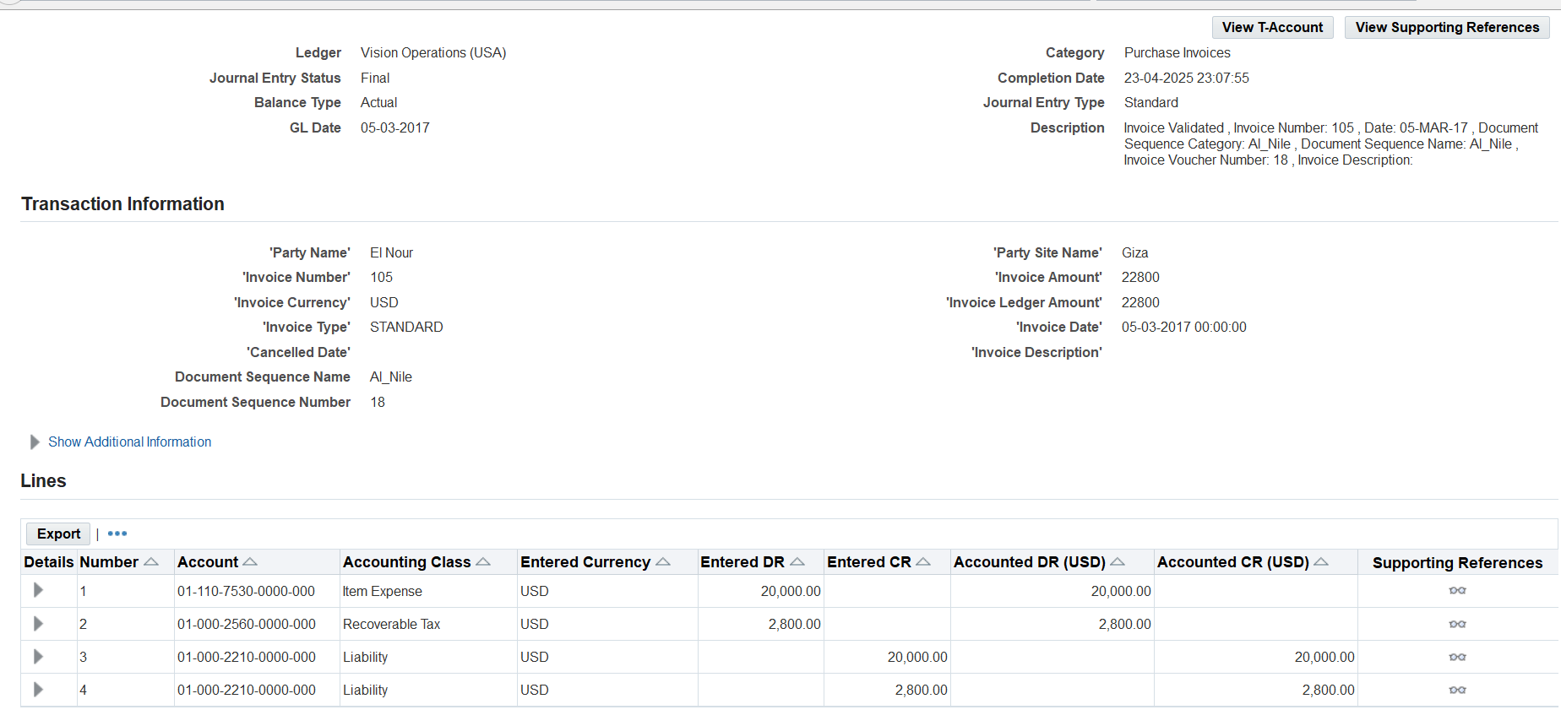
Adjustments Taxation

Slide 48
AP
Step 2: Payment Processing & Cash Management

Slide 49
Payment Processing
(Payment in full or partial)
1-Setup bank information
2-Full payment
3-Partial payment.

Slide 50
Payment Processing
Set up payment bank and bank branches
1-Creat bank (information ,address)
2-Create bank branch
3-create bank account

Slide 51
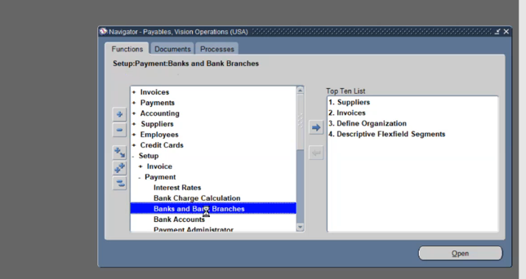
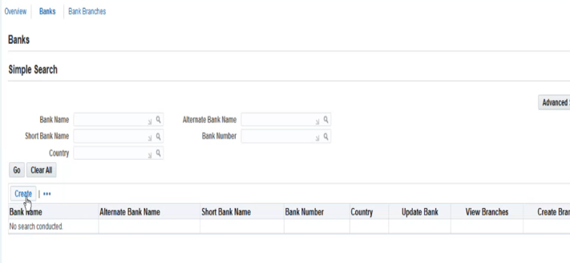
Setup Bank Information

Slide 52
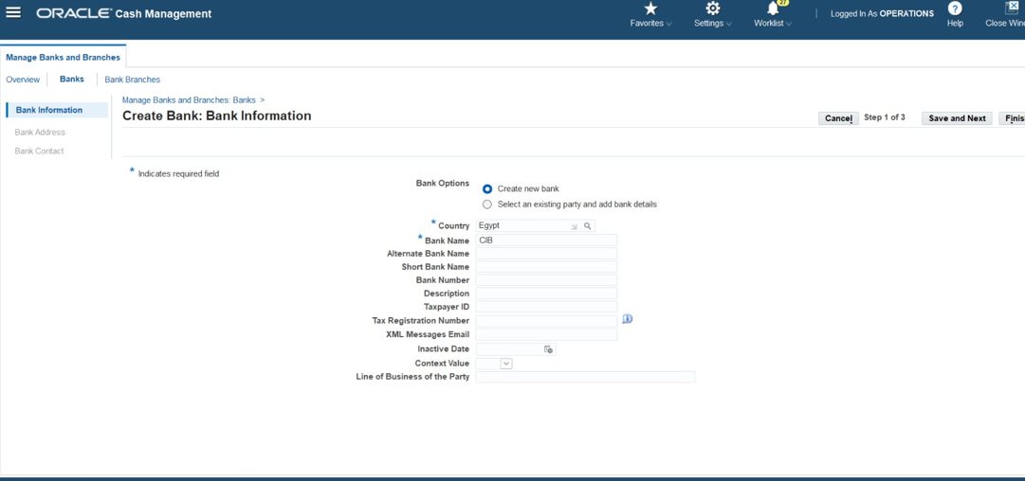
Setup Bank Information

Slide 53
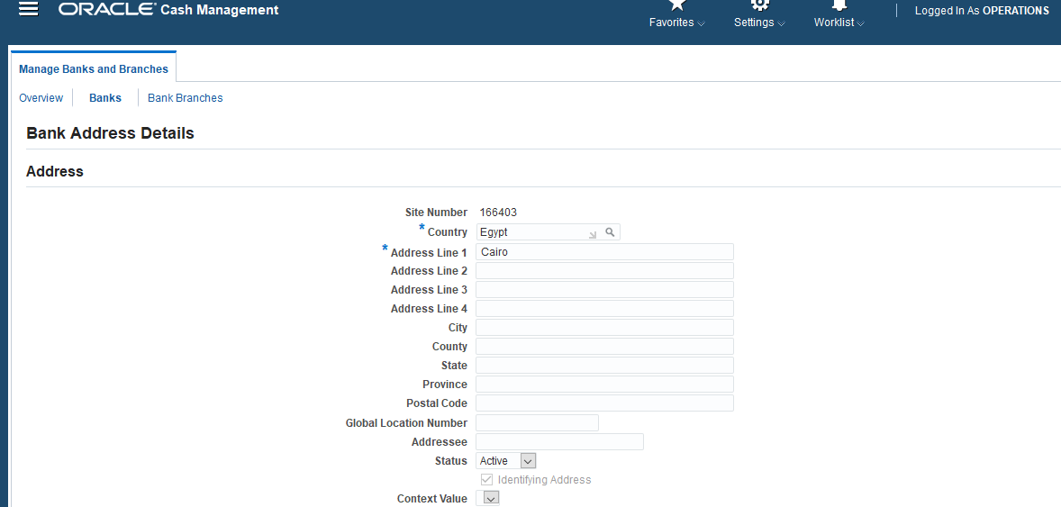
Setup Bank Information

Slide 54
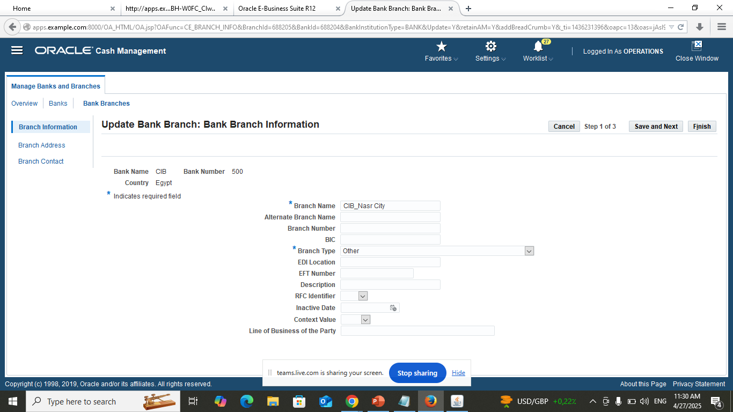
Setup Bank Information

Slide 55
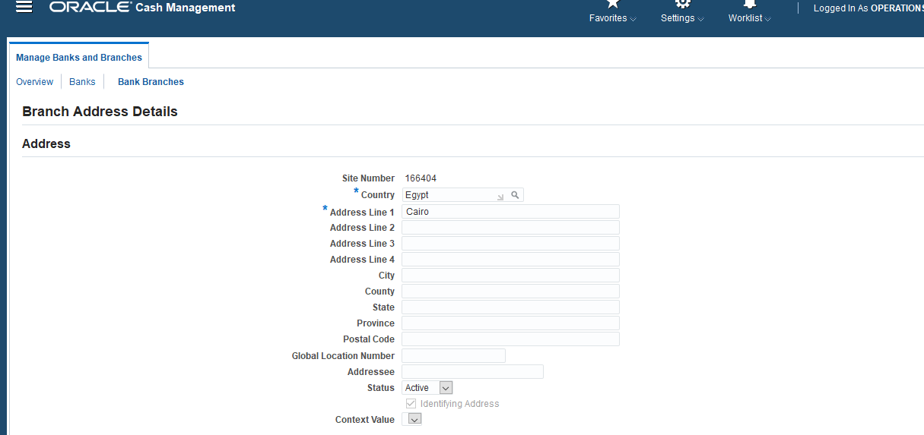
Setup Bank Information

Slide 56
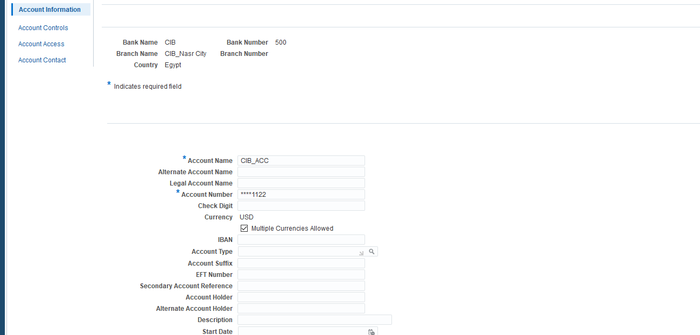
Setup Bank Information

Slide 57
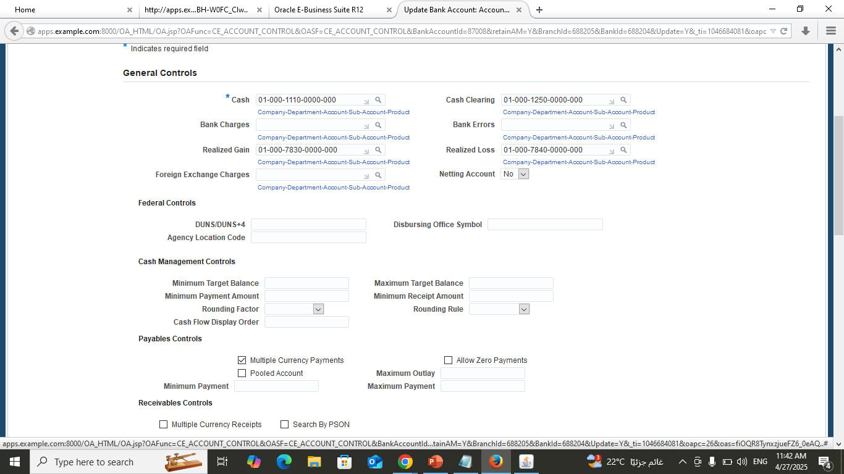
Setup Bank Information

Slide 58
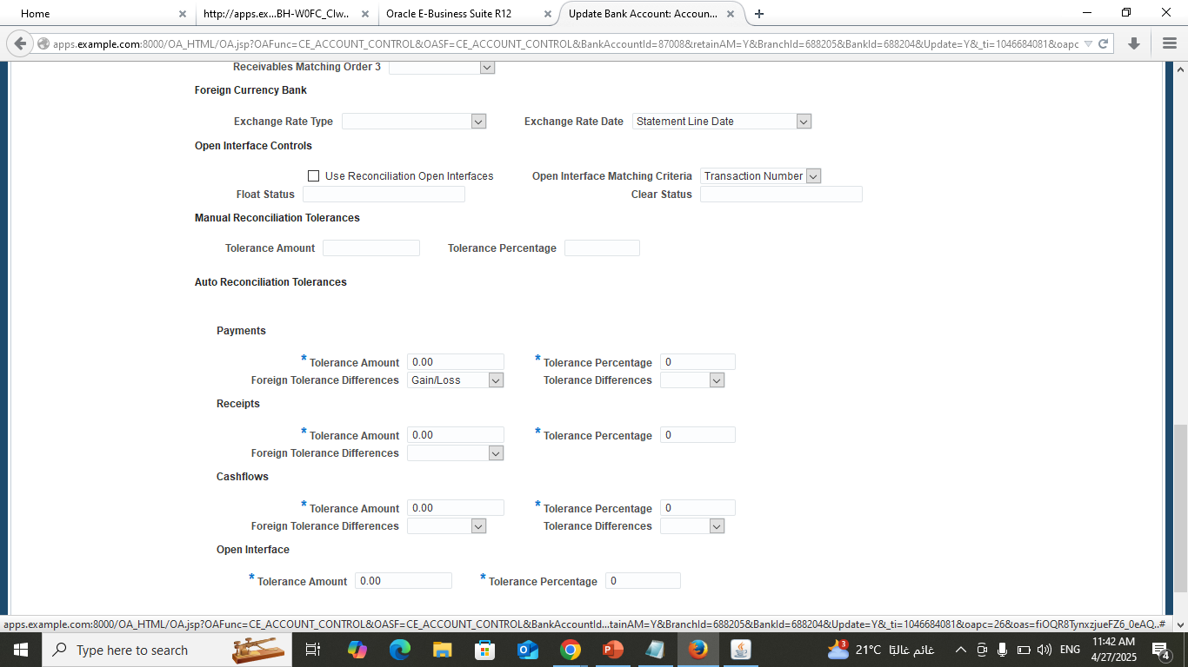
Setup Bank Information

Slide 59
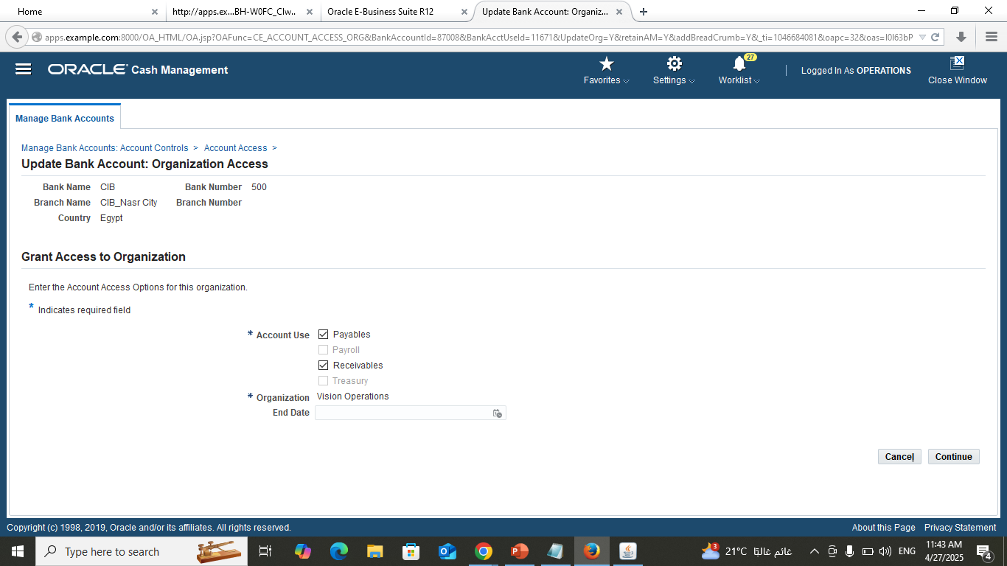
Setup Bank Information

Slide 60
Full and partial payment
1-Total Payment can be done from payment - entry or invoice entry-invoice batch(invoice must be validated).
2-Search by invoice in batch name (status must be validated and create account yes) 3-To Pay in full : action-pay in full Will open payment screen.
4- Check all details (bank account created, currency, payments amount, payment process profile(standard check format), doc no, payment method) save & will show invoice details.
5-Action-create account-final post-ok.

Slide 61
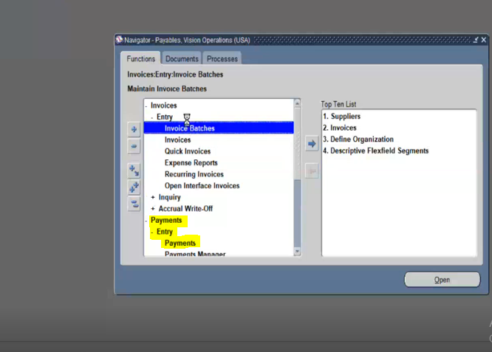
Full Payment

Slide 62
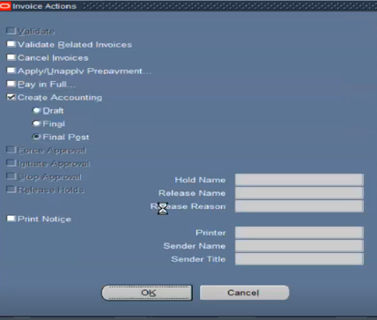
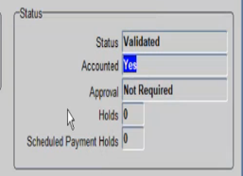
Full Payment

Slide 63
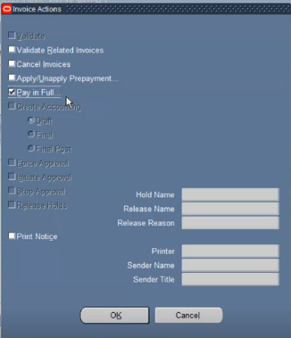
Full Payment

Slide 64
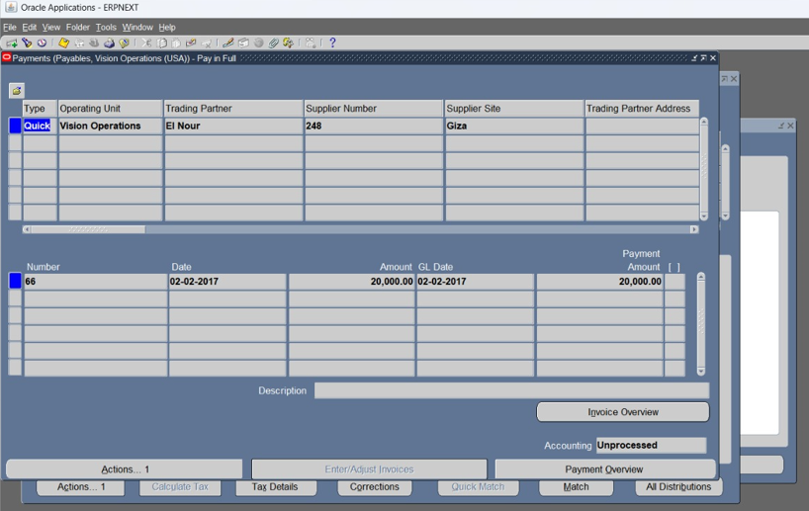
Full Payment

Slide 65
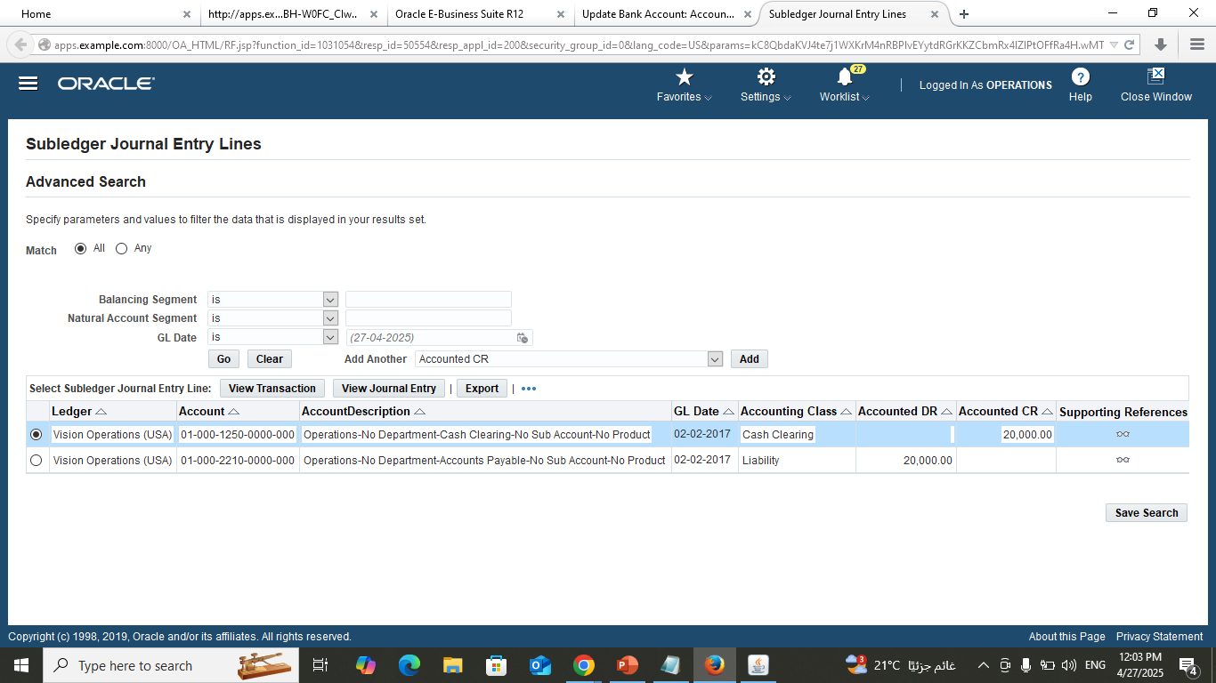
Full Payment

Slide 66
Partial Payment
1-Partial payment must be done only from payment screen
Payment-entry-payments
2-Will find operating unit only & fill all data manually Select payments amount- Enter & adjust invoice
3-Enter invoice No or search by invoice and enter amount partially paid. In Payment amount put the amount will be paid partially.
4-Action create account final post

Slide 67

Partial payment

Slide 68

Partial payment

Slide 69

Partial payment

Slide 70

Performing Refund

Slide 71

Performing Refund

Slide 72

Step 2: Payment Processing and Cash Management
A. Process Supplier Payments
B. Handle Prepayments & Advances
C. Void Payments
& Refunds
Process payments for posted invoices through different ways such as checks or electronic transfers.
B. Invoice Matching (PO Matching)
Process supplier pre-payments & advances in addition to applying pre-payments to future invoices.
Process voids for incorrectly issued payments then, Record refunds from suppliers and apply them to the appropriate invoices.

Slide 73
Al Nile For Furniture Payment Terms
DUE (2 Installments)
Due :50% during 15 Days of the month of invoice (Days of months:15,0)
Due 50% during 15 Days of the NEXT month of invoice (Days of months:15,1(1 REFER TO NEXT MONTH)
DISCOUNT
Discount 1% >>> day of months :10.0
Discount:3% >>> day of months :10,1

Slide 74

Al Nile For Furniture Payment Terms

Slide 75

Processing supplier payment

Slide 76

Processing supplier payment terms

Slide 77

Processing supplier payment terms

Slide 78

Processing supplier payment terms

Slide 79
Prepayments
1-Make invoice with prepayment type
2- Amount account will be automatically given
3-Action-validate
4-Action-creat account final post
5-Action-pay in full
6-From payment page (choose bank and supplier,……..)
7-Click twice on save button
8- Action-create account-final post
9- Make standard invoice to complete transactions

Slide 80

Pre-Payment Setup

Slide 81

Pre-Payment Setup

Slide 82

Pre-Payment Setup
Click twice on save icon

Slide 83

Pre-Payment Setup

Slide 84

Pre-Payment Setup

Slide 85

Pre-Payment Setup

Slide 86

Pre-Payment Setup

Slide 87

Pre-Payment Setup

Slide 88

Pre-Payment Setup

Slide 89

Void Prepayment

Slide 90
AP
Step 3: Period End-Closing & Reporting

Slide 91
Step 3: Period-End Closing & Reporting
Ensure all invoices and payments are posted before closing the period.
A. AP Period – End Close
B. Generate Financial Reports
C. Reconciliation with General Ledger
B. Invoice Matching (PO Matching)
Runing key AP reports such as invoice register, payment register & supplier balance report. Then, Review the reports for accuracy & completeness.
Reconcile AP sub-ledger with the GL then, Ensure all transactions have been correctly recorded & posted.
Process & post write-offs for unpayable amounts then, Review and apply adjustments to close out any remaining discrepancies.

Slide 92

1. AP Period-End Close
AP period-end closing process:
Ensure all invoices and payment are posted.
Path: Accounting → Control Payable Period.
Choose our period → Close all months of the period.
B. Invoice Matching (PO Matching)

Slide 93

2. Generate Financial Reports
(Run key AP reports)
Invoice Register:
Path: View → Request → Submit new Request.
Name: Invoice Register → Parameters: Supplier name, Ok → Operating Unit: Vision → OK →Submit .
Payment Register:
Path: View → Request → Submit new Request
Name: Payment Register → Operating Unit: Vision Operations → Parameters: Date → Display Supplier address: yes →OK →Submit
3. Supplier Balance Report:
Path: View → Request → Submit new Request.
Name: Supplier Open Balance Letter → Date → Supplier Name from: Supplier Name → Supplier Name to: Supplier Name OK →Submit .
B. Invoice Matching (PO Matching)

Slide 94

2. Generate Financial Reports
B. Invoice Matching (PO Matching)

Slide 95

2. Generate Financial Reports
B. Invoice Matching (PO Matching)

Slide 96

Generate AP Financial Reports

Slide 97

Generate AP Financial Reports

Slide 98

Generate AP Financial Reports

Slide 99

Generate AP Financial Reports

Slide 100

3. Reconciliation with General Ledger
(Reconcile the Accounts Payable sub-ledger with the General Ledger.)
Ensure that payment for invoices have been done.
Cash Management Responsibility → Bank Statement → Choose: Manual Clear , Clear Cash → Then select Account Payable.
Write Account Number → Select Date For Payment → Available.
2. Return to Account Payable Responsibility → Payment → Entry Payment → Search By Document No. 1 → Create Account → Final Post
B. Invoice Matching (PO Matching)

Slide 101

Reconcile AP with General Ledger

Slide 102

Reconcile AP with General Ledger

Slide 103

Reconcile AP with General Ledger

Slide 104

Reconcile AP with General Ledger

Slide 105

Reconcile AP with General Ledger

Slide 106

Reconcile AP with General Ledger

Slide 107

Reconcile AP with General Ledger

Slide 108

Reconcile AP with General Ledger

Slide 109


AP Period-End Close

Slide 110
THANK YOU

